Slide 1
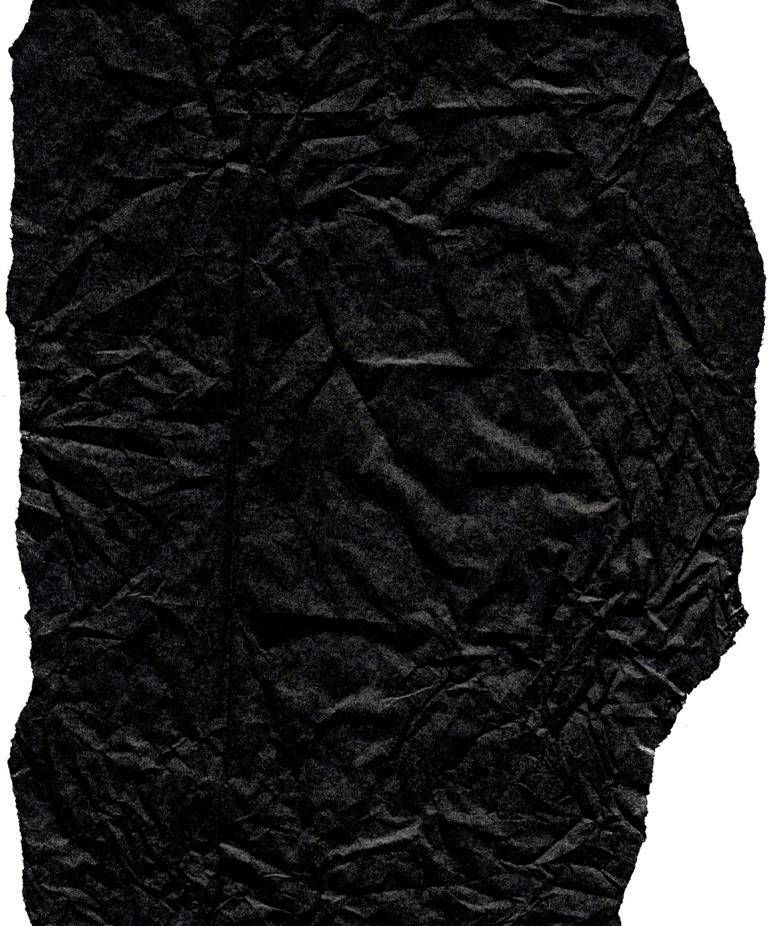




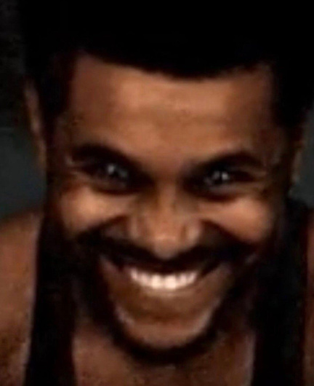



MY PECHA KUCHA
THE WEEKND’S ERAS
By Ana Paulina

Slide 2
Introduction
The Weeknd, born Abel Tesfaye, is one of the most influential artists of the 21st century. His career is divided into distinct eras, each with unique sounds and visuals.

Slide 3
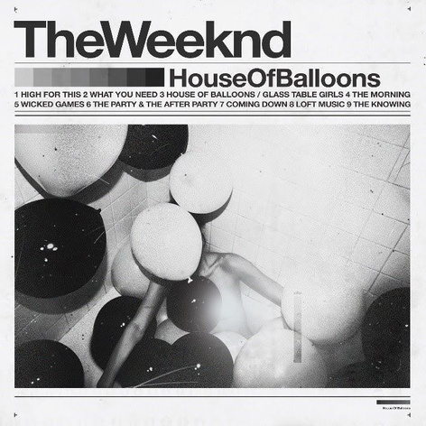
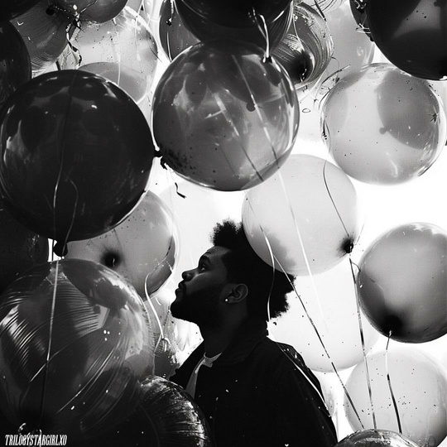
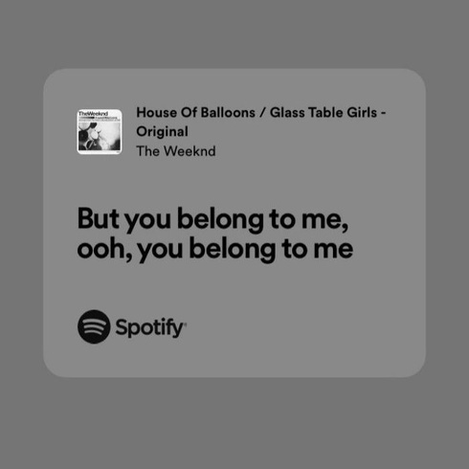
Early Mixtapes (2011)
“House of Balloons,” “Thursday,” and “Echoes of Silence” introduced his dark, mysterious R&B style.

Slide 4
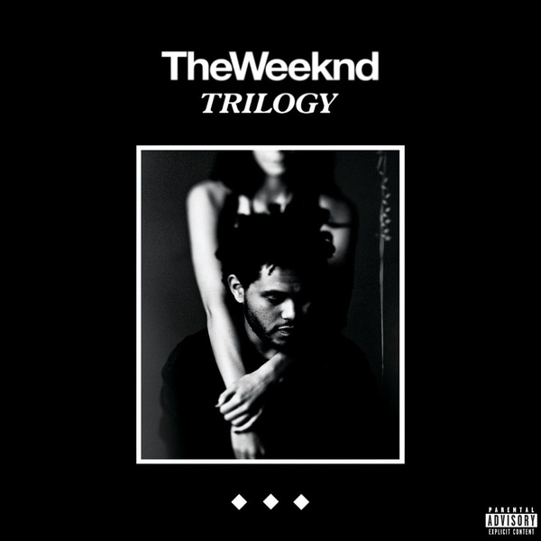
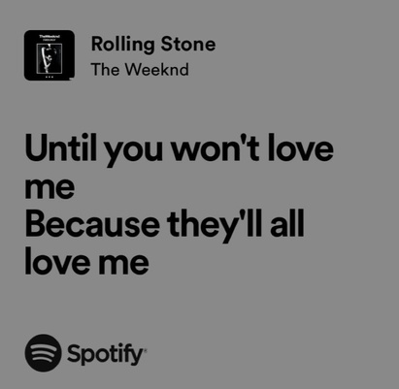

Trilogy (2012)
The three mixtapes were repackaged into Trilogy, marking his official industry entry.

Slide 5
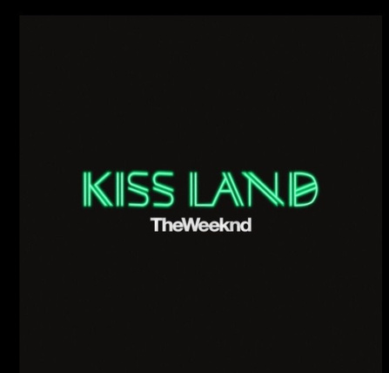
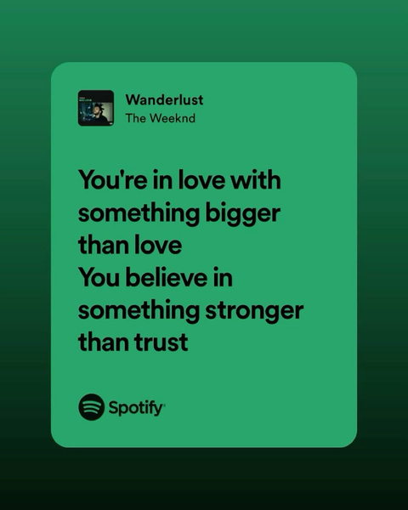
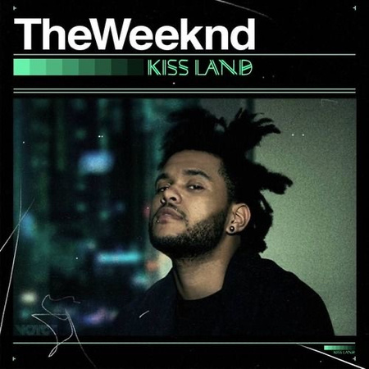
Kiss land (2013)
Experimental, cinematic, and Japanese-influenced visuals showed his ambition to expand his artistry.

Slide 6
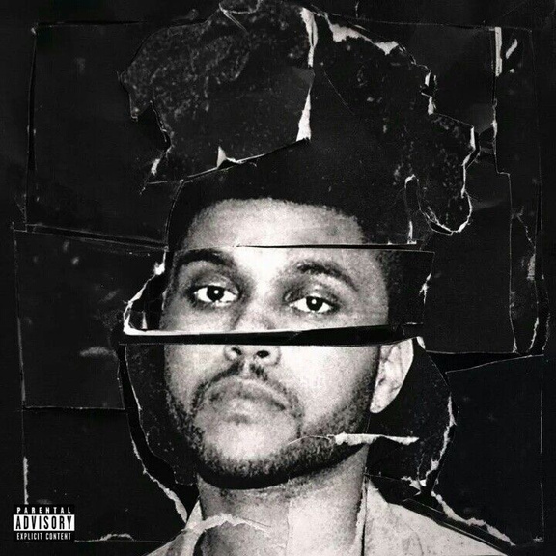
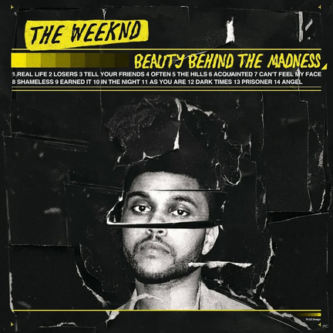
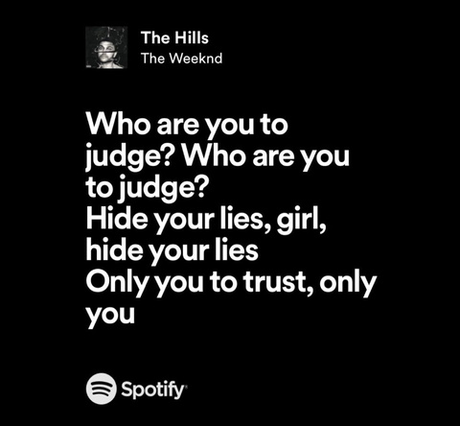
Beauty Behind the Madness (2015)
Mainstream breakthrough with “Can’t Feel My Face” and “The Hills.” Pop mixed with dark R&B.

Slide 7
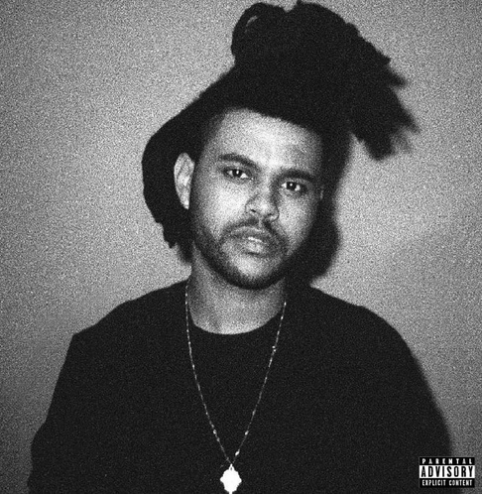
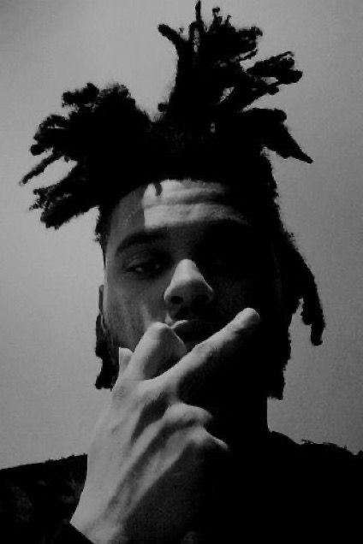
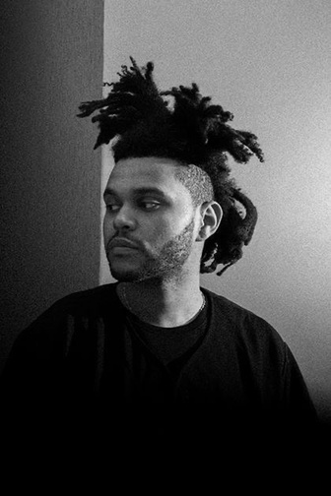
Iconic Look (2015)
His tall, unique hairstyle became his symbol during this era.

Slide 8
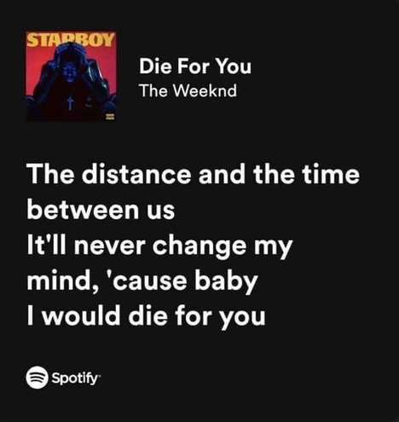
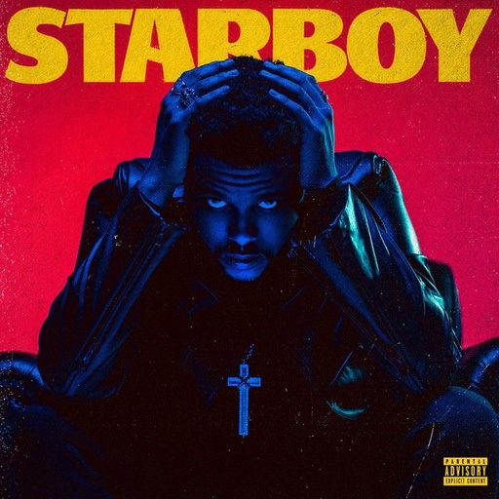
Starboy (2016)
Collaboration with Daft Punk. Sleek visuals, futuristic sounds, and reinvention.

Slide 9
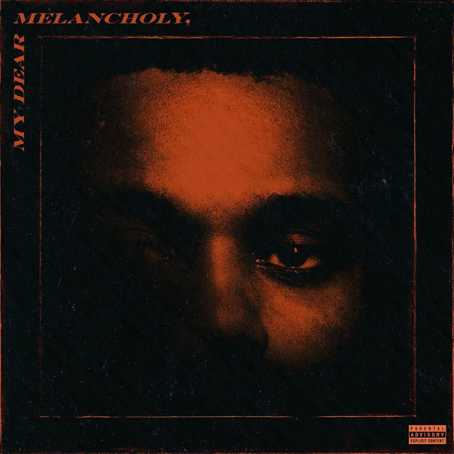
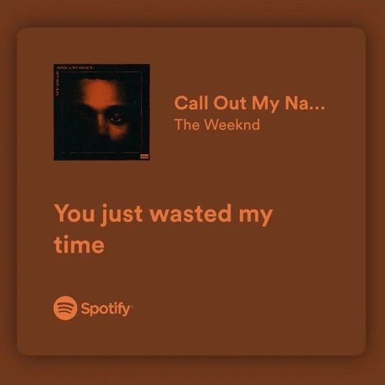
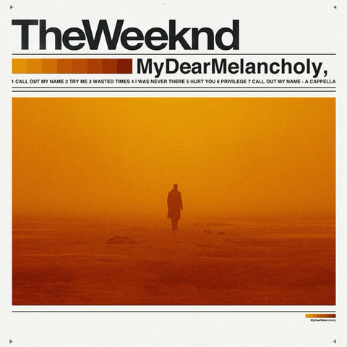
My Dear Melancholy (2018)
A return to his emotional and darker roots. Short but powerful project.

Slide 10
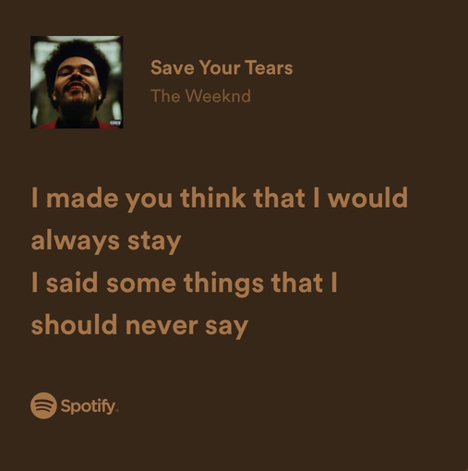
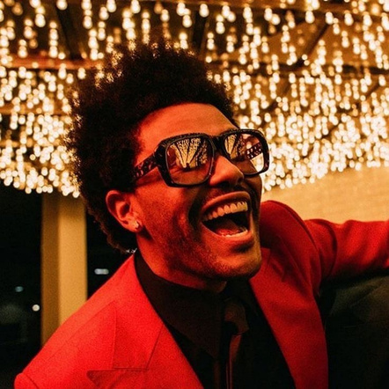
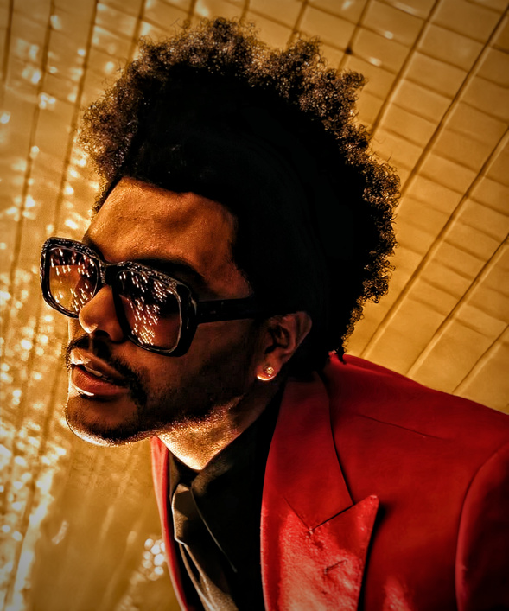
After hours (2020)
Red suit, bandaged face, and neon visuals. A cinematic era blending synthwave, pop, and R&B.

Slide 11
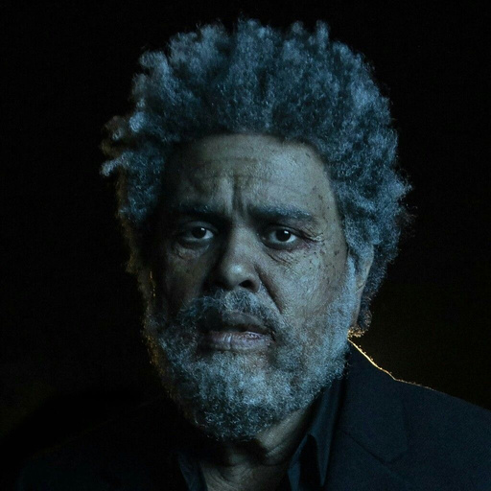
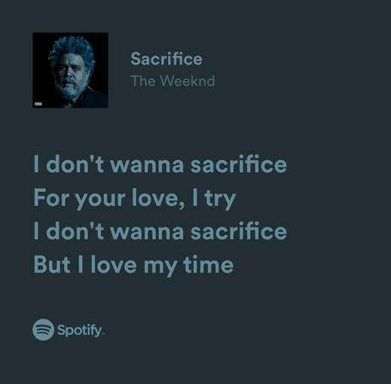
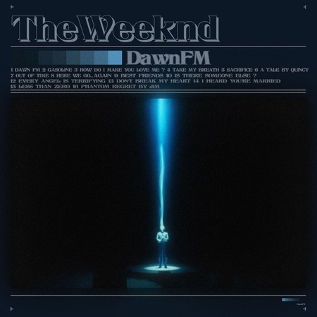
Dawn fm (2022)
Concept album with radio-style narration. Themes of purgatory, reflection, and mortality.

Slide 12
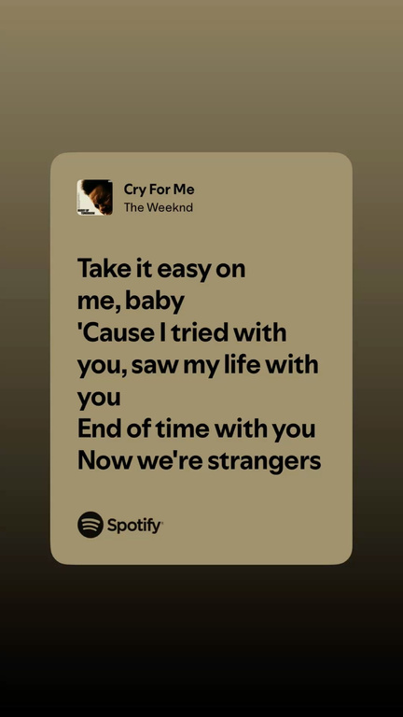
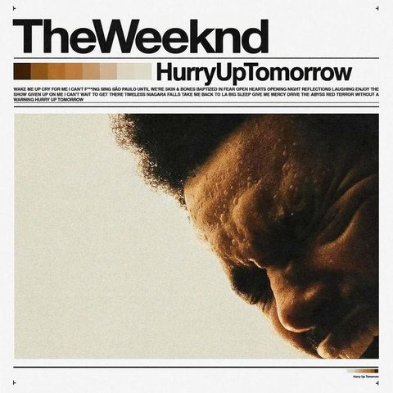
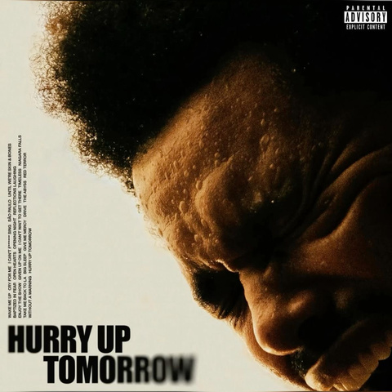
Hurry up tomorrow (2025
A darker, futuristic transition era. It bridges Dawn FM and his upcoming “final trilogy” album.

Slide 13
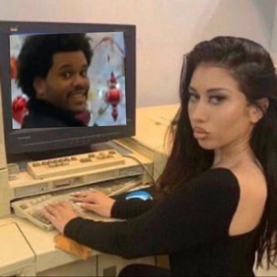

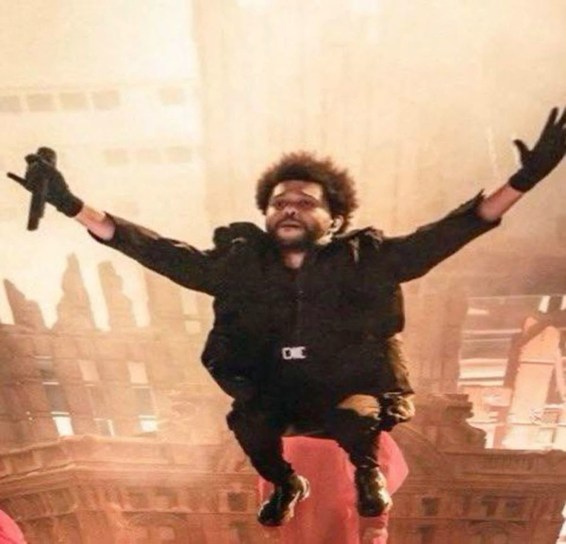
Global tours
His tours became immersive, with huge LED stages and futuristic designs.

Slide 14
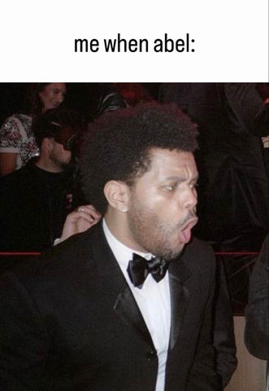
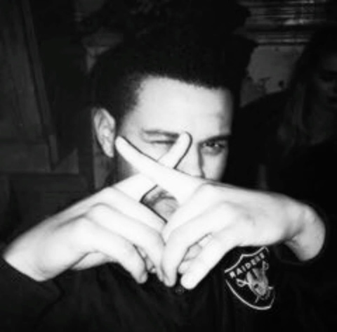
Current legacy
The Weeknd is not just a musician but a visionary shaping pop culture and aesthetics.

Slide 15
5 cons of The Weeknd

Slide 16
There are no cons

Slide 17
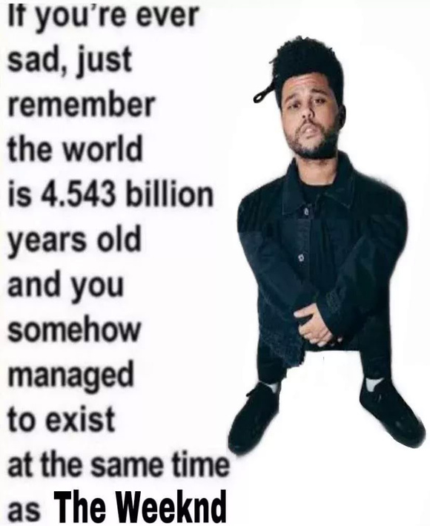
Cultural impact
The Weeknd has shaped pop culture with his sound, visuals, and viral internet moments.

Slide 18
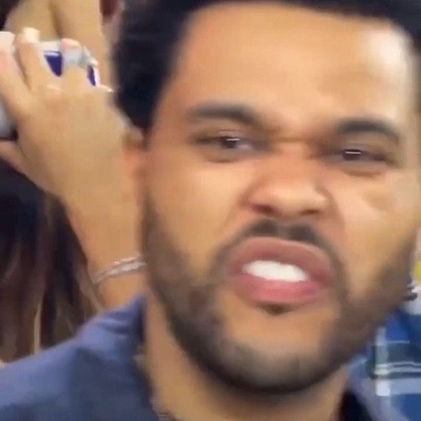
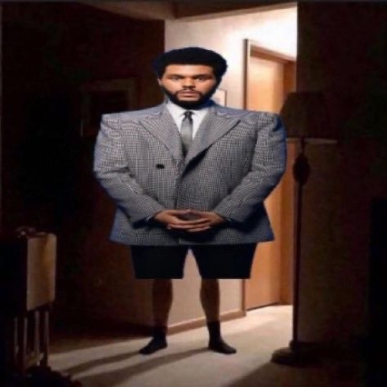
Philanthropy
He has donated millions to education, health, and humanitarian causes worldwide.

Slide 19
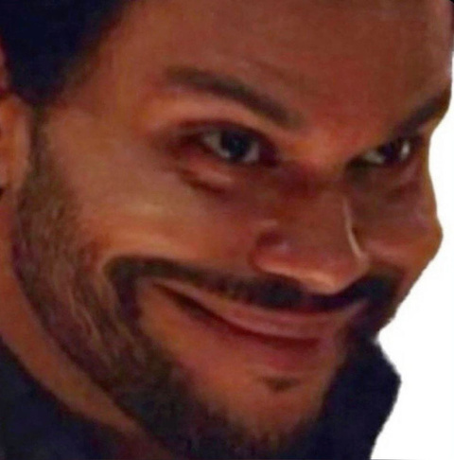
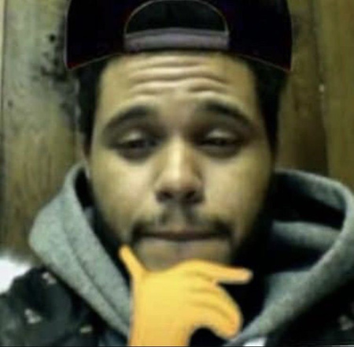
Conclusion & Legacy
From underground mixtapes to stadium tours, The Weeknd continues to define an era in music.

Slide 20
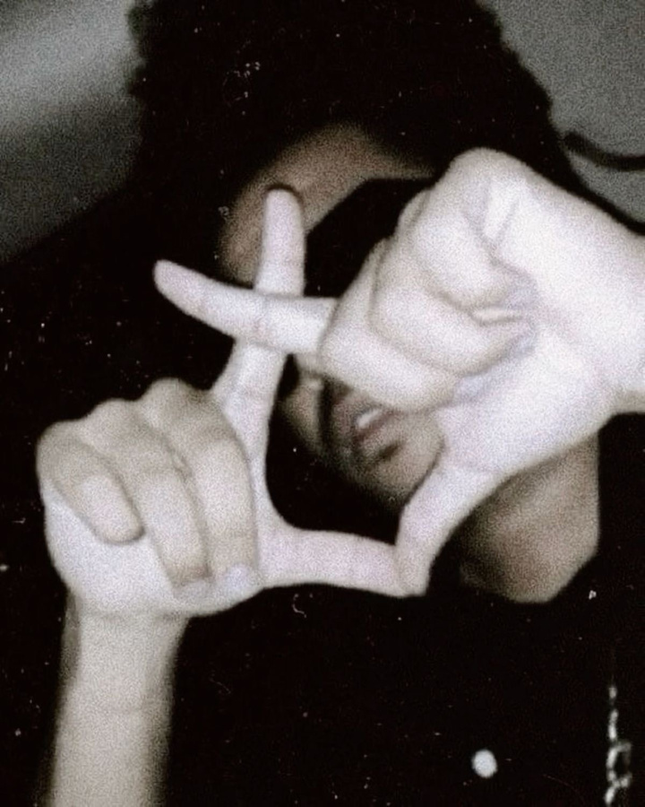
Thank you

