Slide 1

WHAT IS THERE HERE? Presented by Natalia Caro

Slide 2

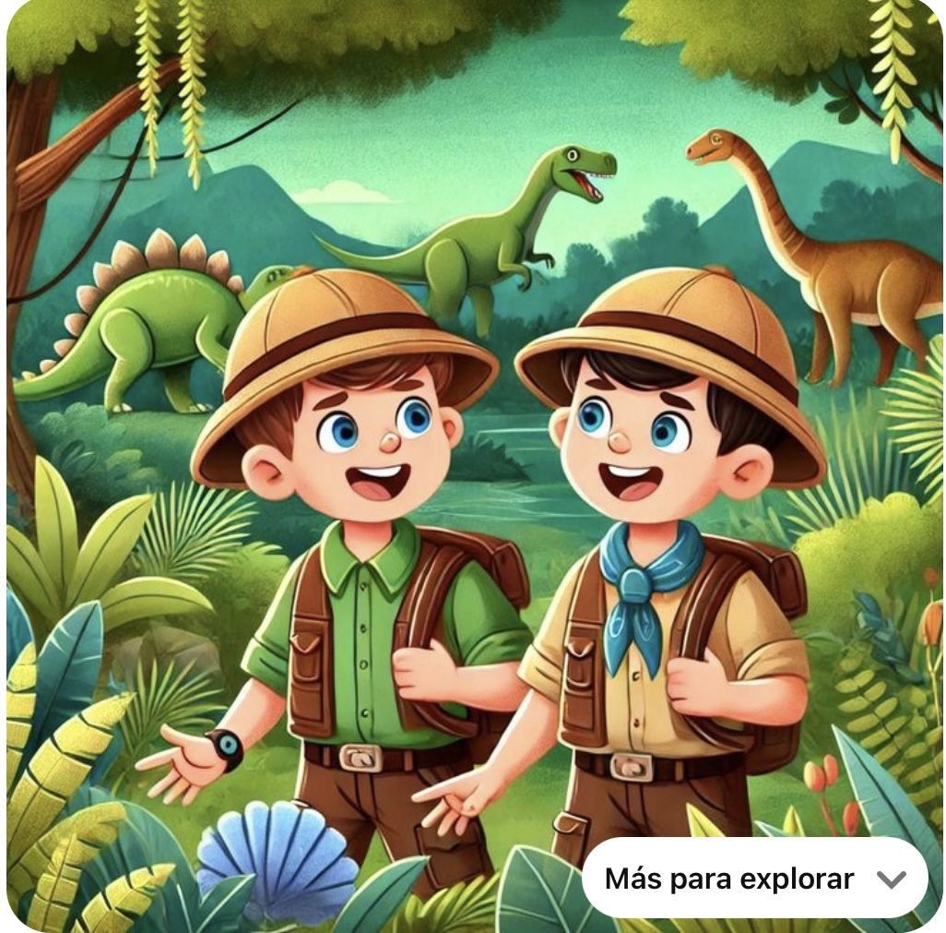
What is there in the jungle?
This place is a jungle, there are two kids, there are there dinosaurs behind the kids.
There is a Watch on the kids hand, there are some mountains behind.

