Slide 1
París
Emmanuel Camacho López

Slide 2
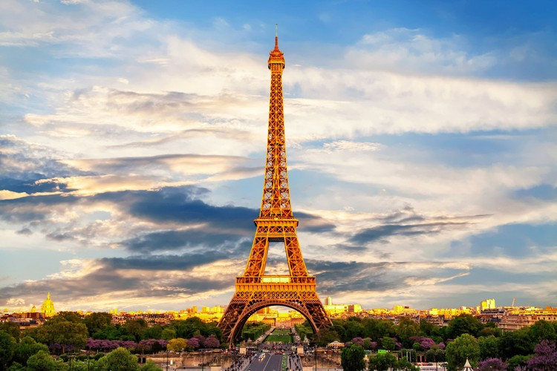
Important information
It is the capital of France and one of the great European cities.

Slide 3
the 3 most important things in paris
The Eiffel Tower The Louvre Museum: Notre Dame Cathedral

Slide 4
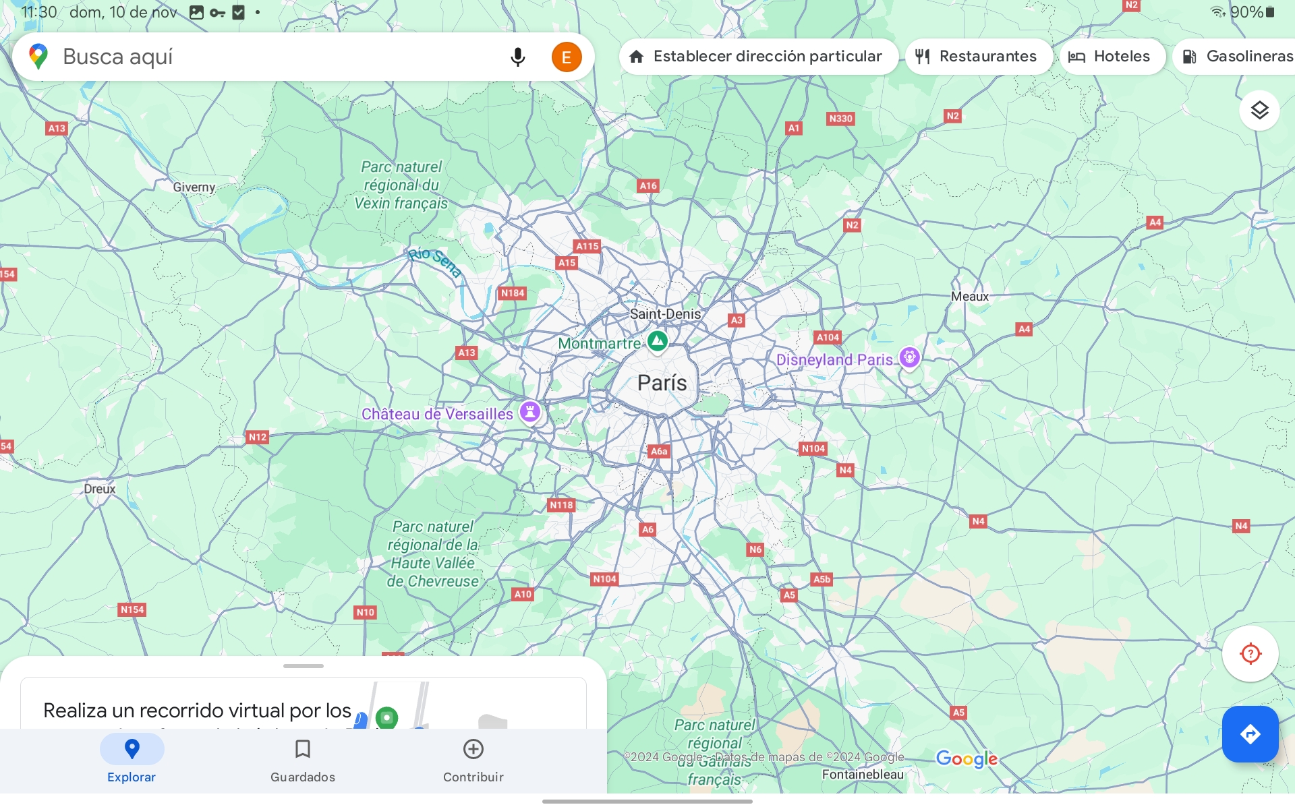
maypitaq tarikun
Northern France

Slide 5
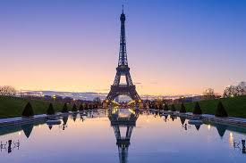
Characteristics of the police
Quieto
familia
Colorful
Loving
big
expensive
rude
see

Slide 6
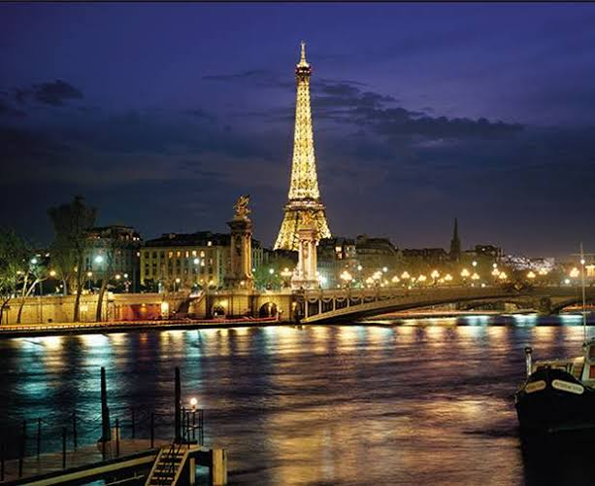
Thank you for your time

