Slide 1
Brian Obed Cruz López
English
Bertha

Slide 2
What’s hermosillo like?

Slide 3
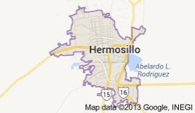
LocaTION
Mexico and sound is that just

Slide 4

Climate
Twenty-one

Slide 5
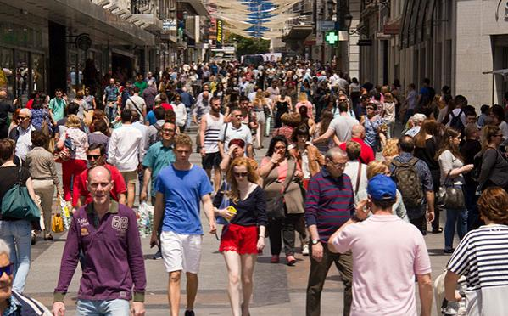
Population
1.43M personas

Slide 6
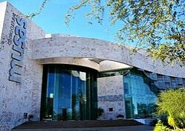
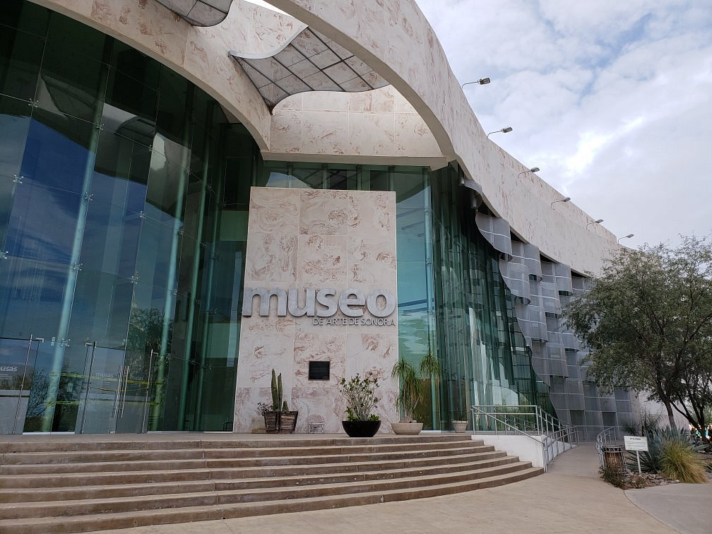
Atractions
Sonora Art Museum
Museum of popular culture

Slide 7
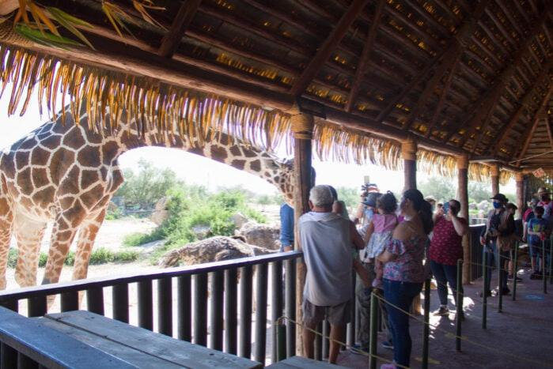
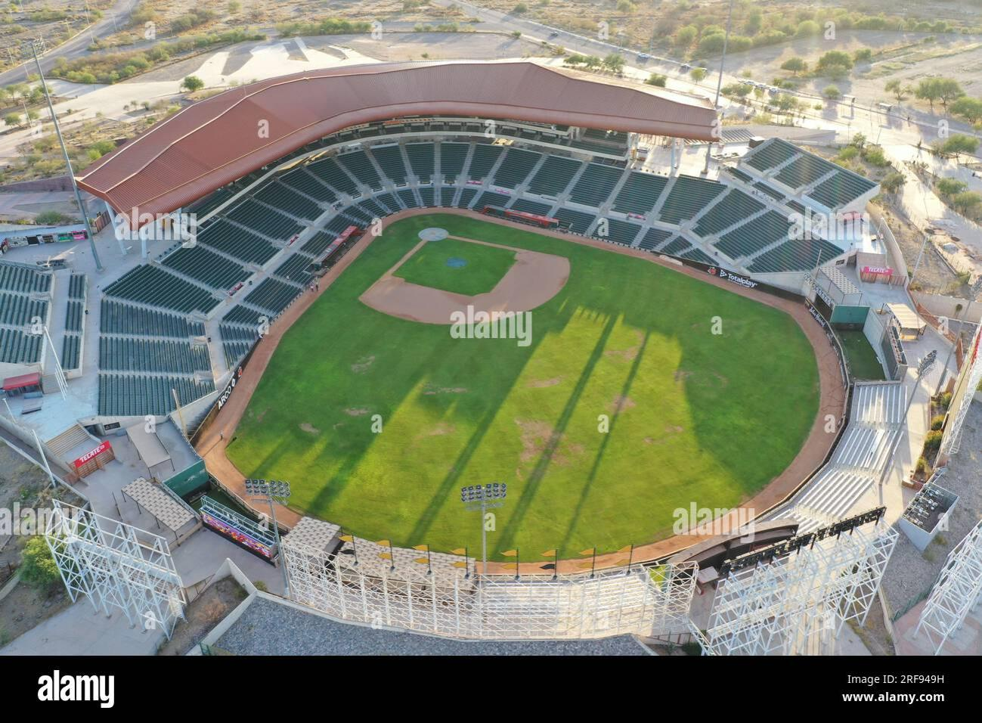
Actividades
Sonora Ecological Center
Ferronando Valenzuela Stadium

Slide 8
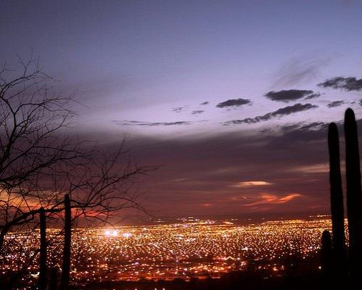
Landscape
desert

