Slide 1
DRACULA

Slide 2
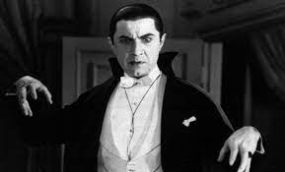
WHO IS DRACULA
Count Dracula is the protagonist of the 1897 Irish writer Bram Stoker's gothic horror novel of the same name. He is considered the prototypical and archetypal vampire in later works of fiction, which gave rise to a long list of versions of the character in cinema, comics and theater.

Slide 3
CHARACTERISTICS
They avoid human contact, since they prefer solitude . Bloodthirsty evil being. Selfish and tyrant.

Slide 4
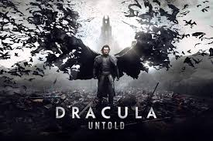
LEGEND
Drácula is a real charecter from the XV century prince of valquia , brave , figheter angainst the impirealisim otomano because the Independence of his country, put pretty crucial with his enemies qualities that confirm his inmortality from some historic charecters

Slide 5
WHAT DOES HE DO
Drácula is describe like a crucial person and maligno of strong power and skills. Van helsing describen him with a lot of strength unlimited to a human beaing also like a Deep iq over a human beaing and wisdom sharpned over sevreal centuries. But he mostly like to scare people and run them away.

Slide 6
Story #1
In some editions, the novel is preceded by the terrifying tale Dracula's Guest or Dracula's Guest. In it, Jonathan Harker, a young English lawyer who is traveling to Transylvania, is still in Munich, from where he will have to take a train that will take him to Vienna and then to Budapest.

Slide 7
Story#2
One afternoon, from Munich, he goes for a ride in a horse-drawn carriage. As the day is not far away, the coachman wants to return because that is Walpurgis night. Like a good Englishman, Jonathan dismisses the coachman and continues the ride alone on foot along a mysterious path that deviated from the main road.

Slide 8
Story#3
Following that path for a couple of hours, he enters a dark forest that begins to become hostile with every step he takes. It becomes night and it begins to snow, while the young man perceives a malevolent presence around him.

Slide 9
Story#4
The storm grows stronger and Jonathan is swept into what appears to be an abandoned cemetery. Seeking shelter from the thunder, he heads to a white marble chapel that he believes is safe. On its exterior, carved in the stone it reads: Countess Dolingen of Graz, in Styria, sought and found death. 1801 and another inscription in German that reads

Slide 10
Story#5
Denn die Toten reiten schnell" ("Because the dead travel quickly", fragment quoted from the poem Lenore, written by Gottfried August Bürger. The frightened young man opens the door and finds that the body of a woman is resting on a stone catafalque. beautiful young woman with blood-stained lips. At that moment, lightning strikes the chapel and it begins to catch fire.

Slide 11
Story#6
What appeared to be the corpse of the suicidal woman rises from her bed and begins to give horrible screams of pain in the middle of the fire that consumes her. The frightened young man runs in the face of what seems impossible to him and falls in the snow as the storm rages. When he comes to his senses he feels that a wolf is sniffing his neck and warming him. The animal flees when a group of men with torches find him, as they had gone out to look for him, having reported from the coachman that the young man had gone alone into the forest. When the protagonist is finally returned to his hotel, a telegram awaits him from Dracula, whom he is going to meet in Transylvania, and in which he warns him of the dangers of snow and wolves at night.

Slide 12
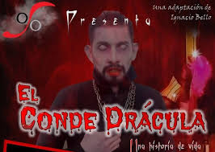
The End TO BE CONTINIUED

