Slide 1
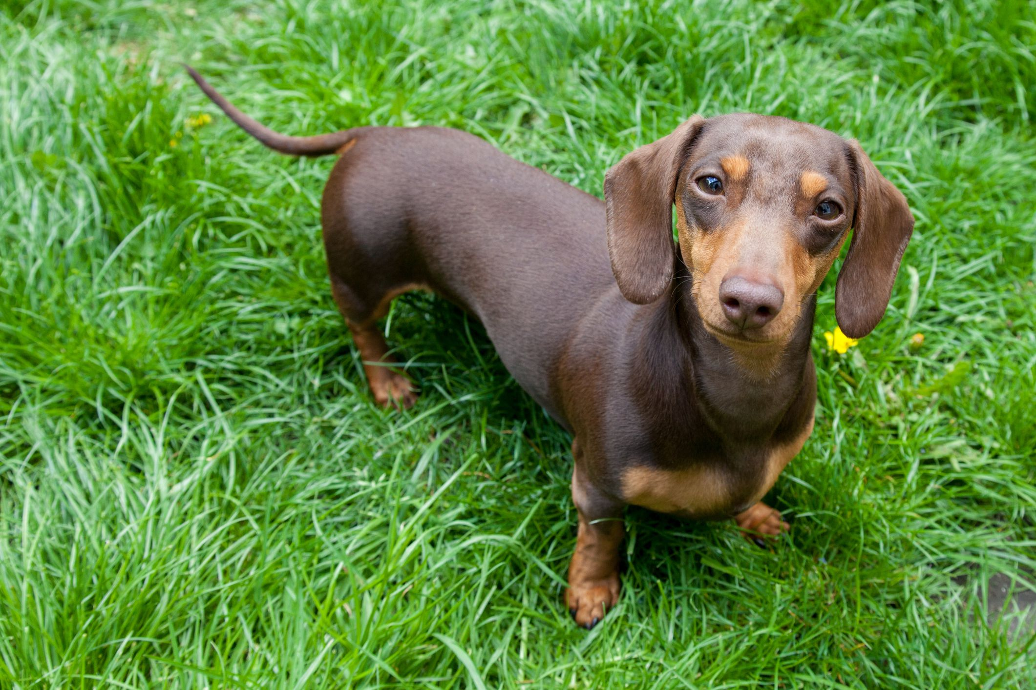

DASHUNT DOG
Canis lupus familiaris

Slide 2
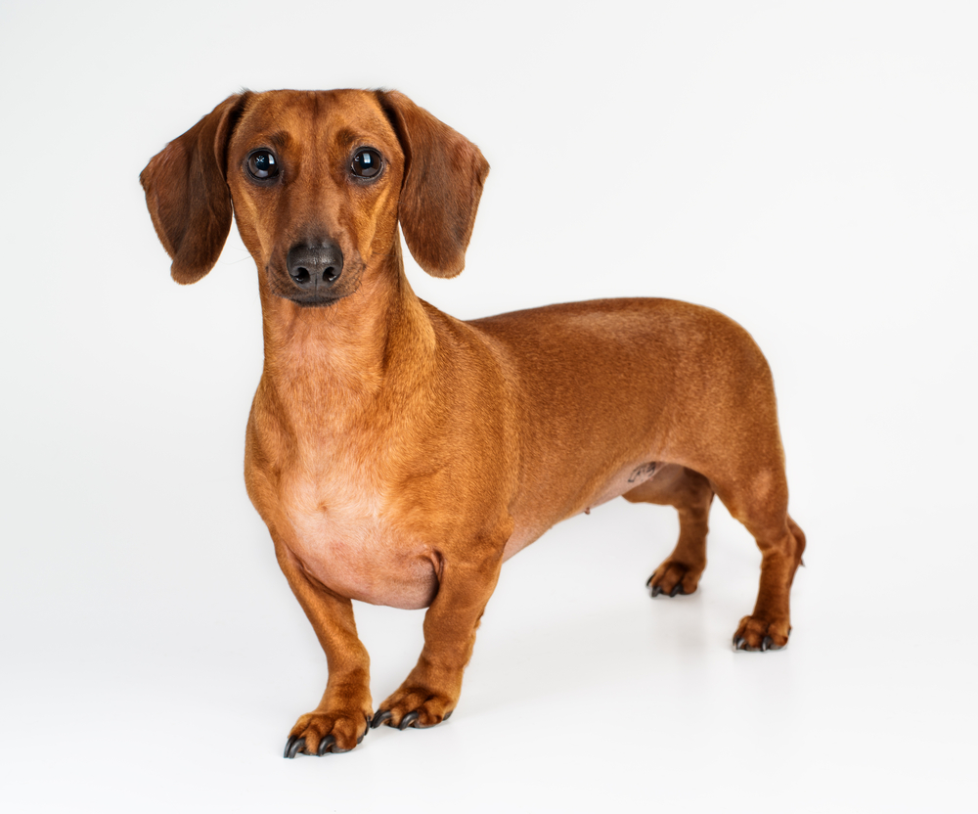
ORIGIN
The dachshund originated in Germany as a hunting dog. Though its origins can be traced as far back as the 15th century, the breed's development really began in 17th century Germany. Called dachshunds, which translates as "badger dogs," these short hounds did just that—they hunted badgers.
so the earliest date dashunt wear discovered between 1401 and 1500

Slide 3
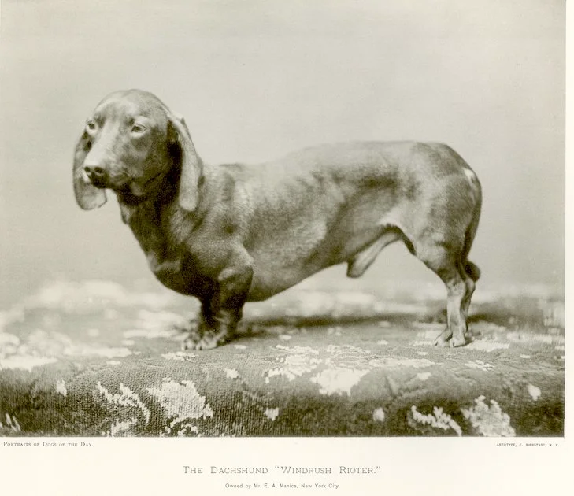
when did humanity got to interact with dashunts?
Germans created this breed in the 15th century but the breed really developed in the 17th century by crossing a German Shorthaired Pointer, a Pinscher, and a Bracke
so thsis breed its created by humanity that means is not a natural breed
Arapey

Slide 4
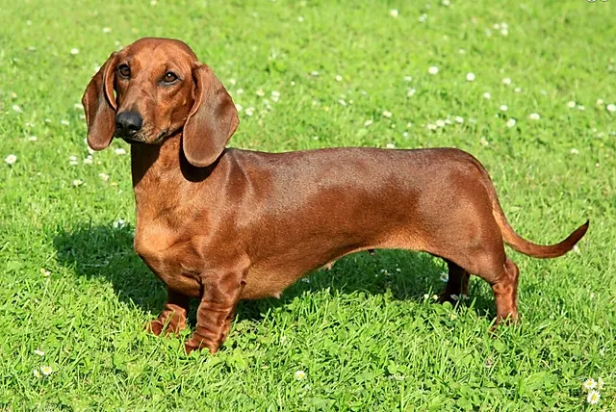
PYSICAL APPEREANCE
A typical dachshund is long-bodied and muscular with short stubby legs. Its front paws are disproportionately large, being paddle-shaped and particularly suitable for digging. Its skin is loose enough not to tear while tunneling in tight burrows to chase prey.

Slide 5
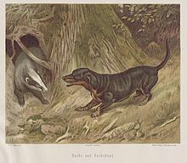

17th century
the dashunt originally had longer paws and they were a little less long

Slide 6
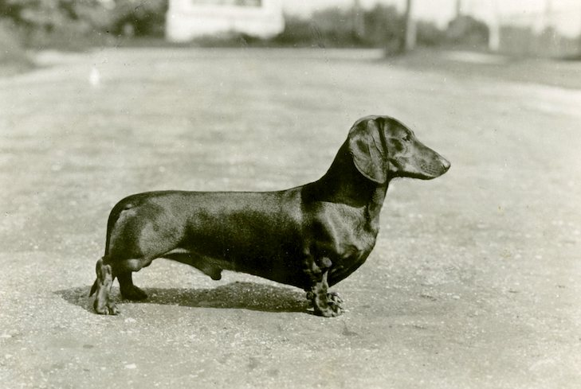
18th to 19th century
later the dashunt was modified to have flat ears and a curved tail thi sin order to prevent dirt entering into its ears and..😁

Slide 7
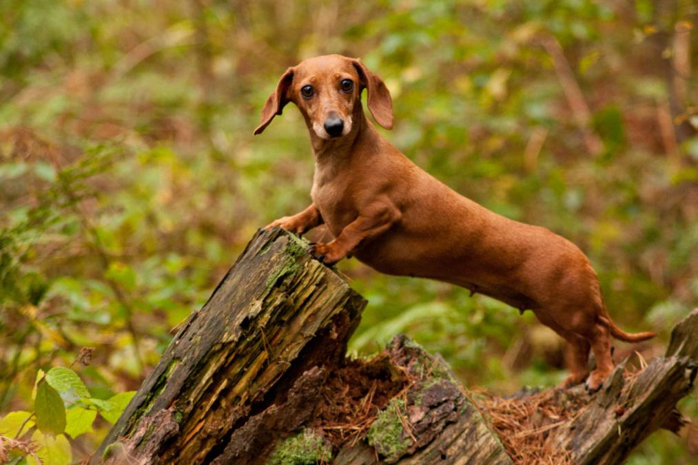

19th century to the actuality
the dashunt evolved to a hunting dog with agressive behavior and a body shape to hunting to a small non agressive dog to become a house pet

Slide 8



THANKS FOR YOUR ATTENCION!!!!!!!

