Slide 1
presentation

Slide 2
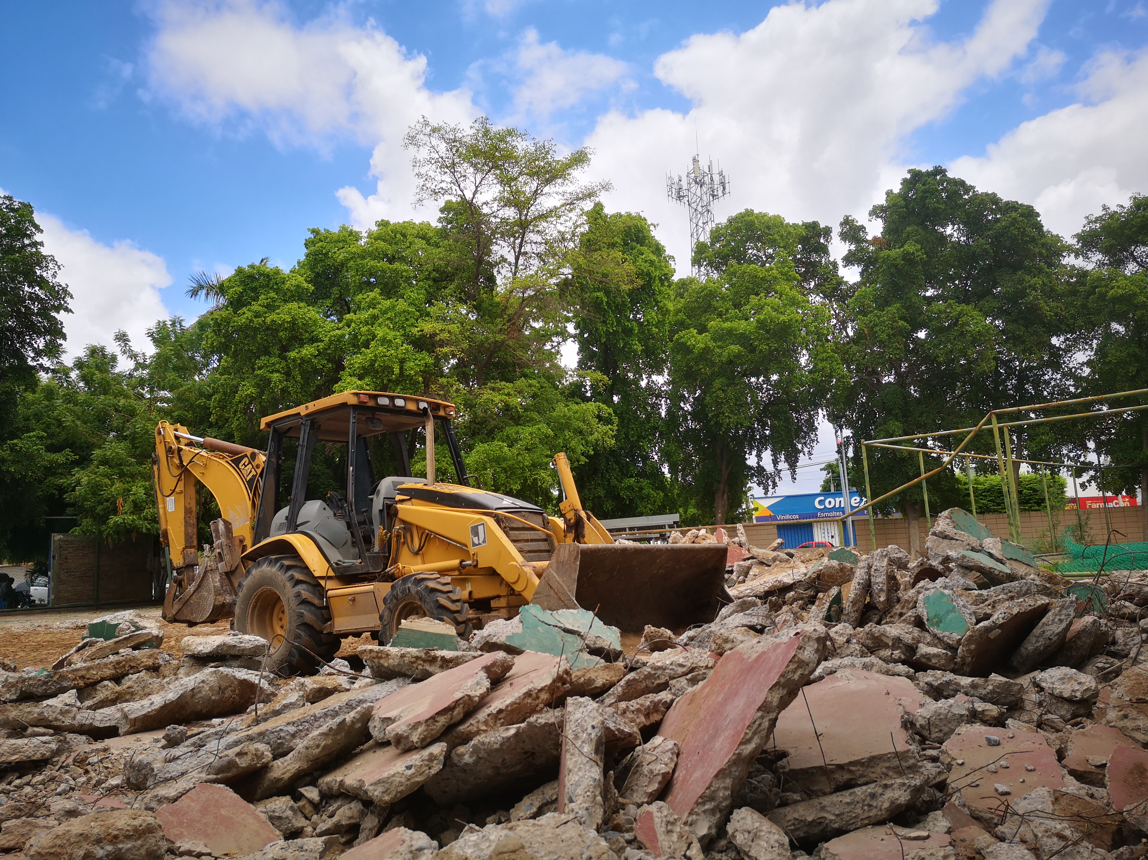
Here we can see how they destroy a common area of ​​the park where there is a yellow truck and next to a ball of green debris like a couple of trees, also in the background we could see a blue paint stand that stands out a lot because of its white letters.

Slide 3
end

