Slide 1
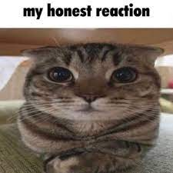
Talking about photographs
Jorge Ivan Montiel Lopez

Slide 2
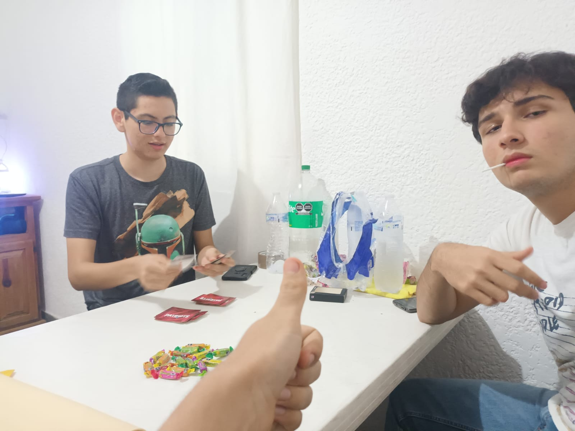
In this photo I was with my best friends from the INEI. Waldo and Edu. in the edu's house and in this photo we were betting sweets playing blackjack while the model was drying.

Slide 3
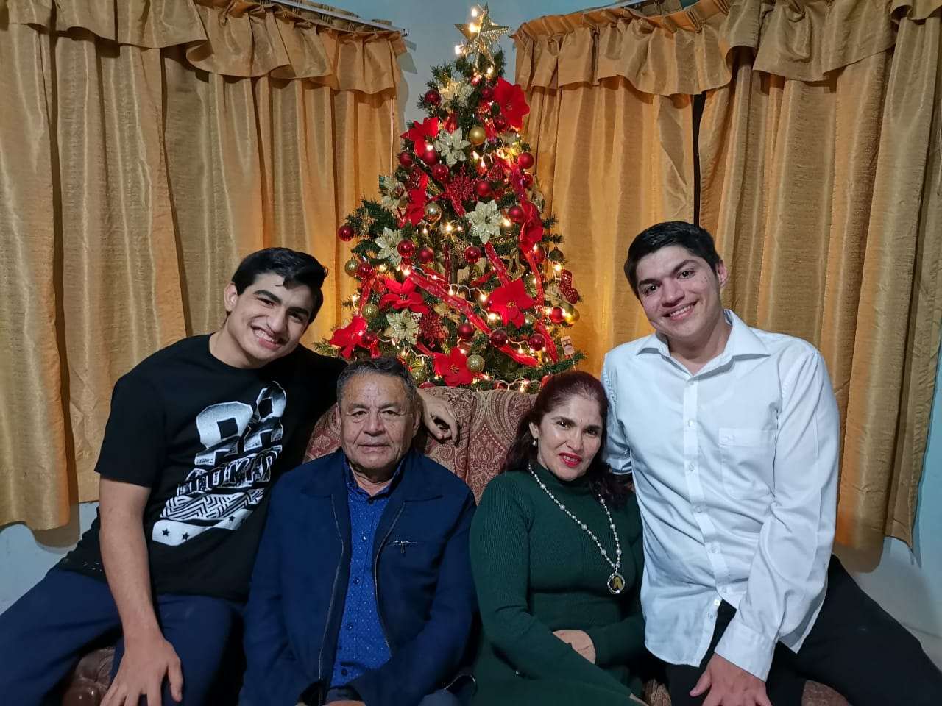
In this photo I´m with my family. My mother Carmina, my father Jorge and my brother Ricardo. I took this photo at my house in Guasave on the first day of the year this year. I really like spending time with them now that we see each other less and less (with my brother)

Slide 4
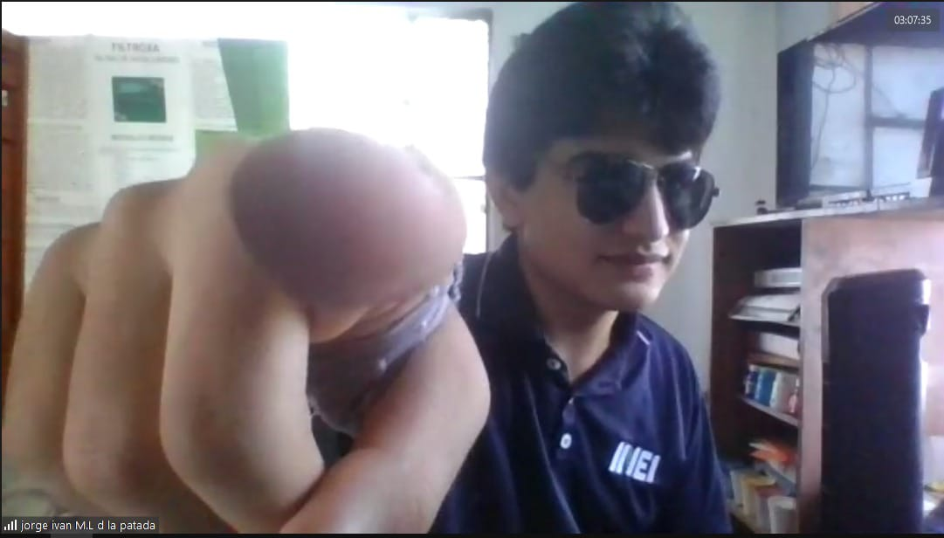
This is me studying in an online class in 2021 at a more schizophrenic moment because in the INEI online class they were on zoom and we had 10 minutes free between classes and in that time we could do different things.

