Slide 1
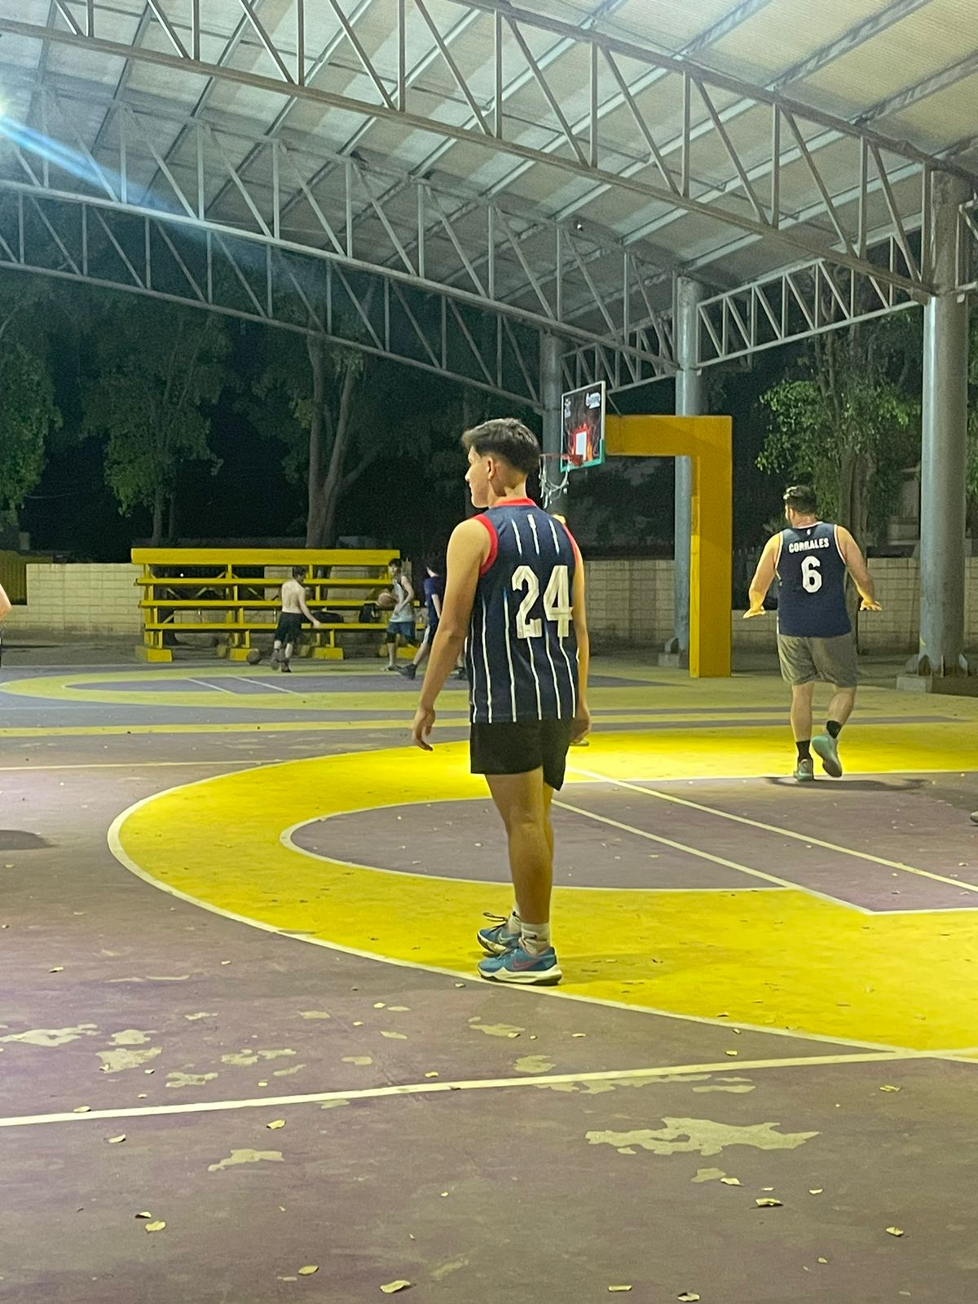
In this photo I am playing basketball which is a sport that I really like. When I play basketball I feel relaxed, happy and free.

Slide 2
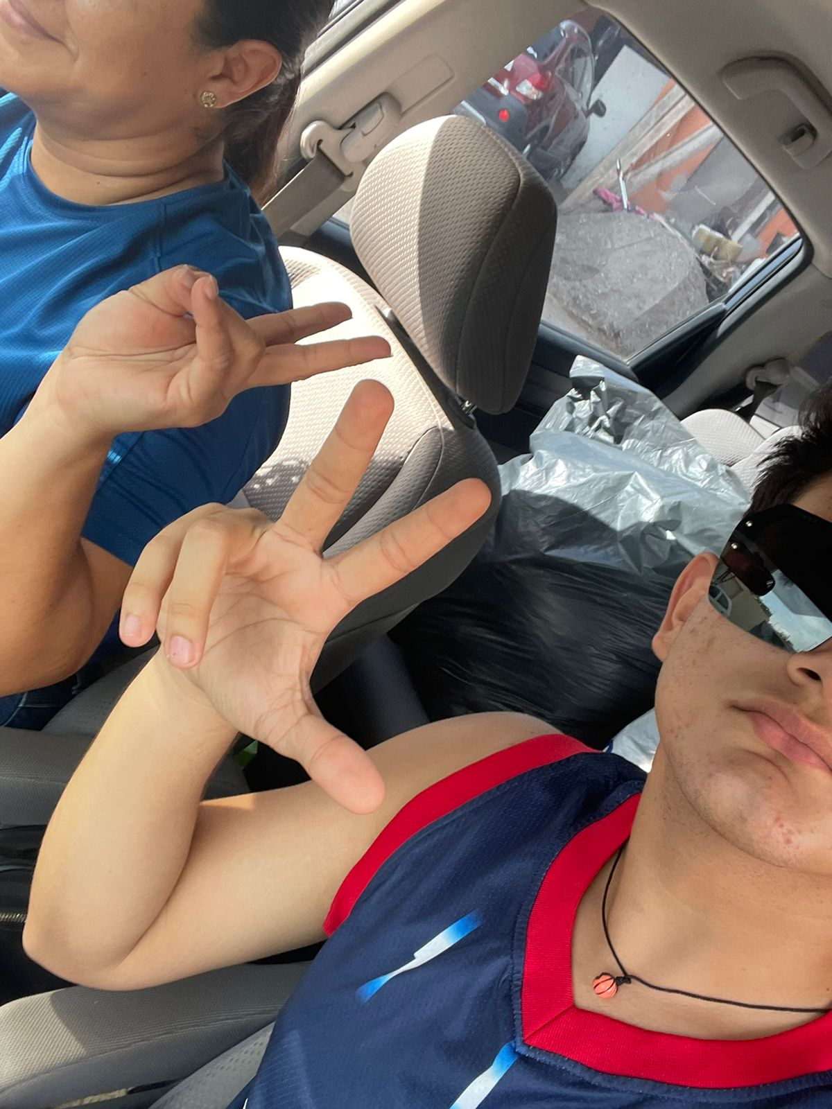
In this photo I am with my mother, we were going to go back, when I am with my mother I feel very safe and happy, which is why I love her very much.

Slide 3
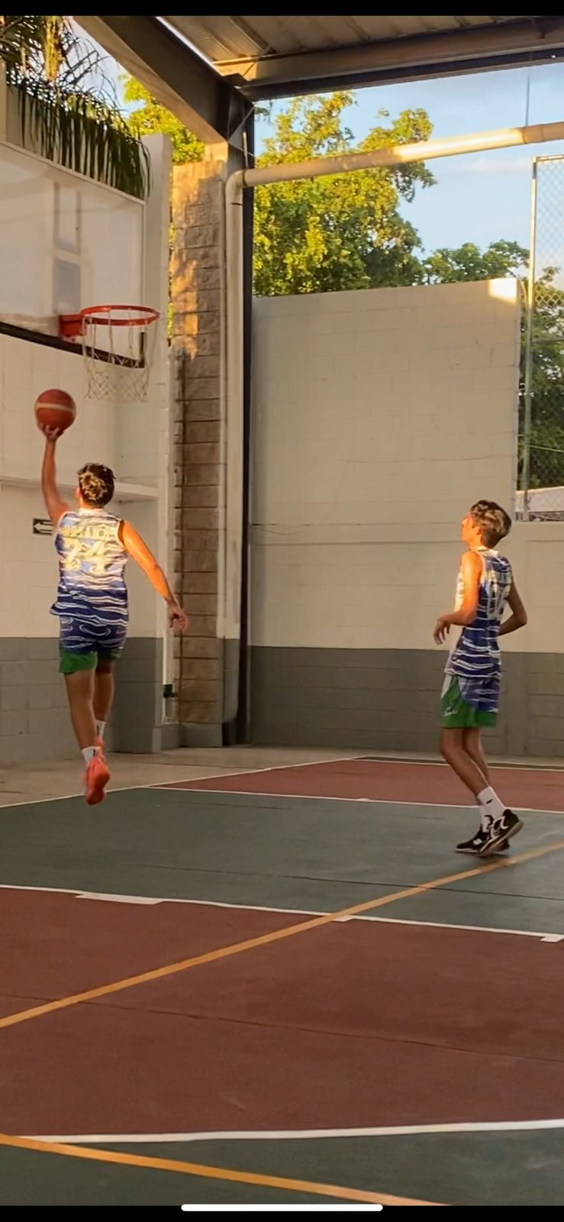
In this photo I am with Chedu, my duo who I always play with him, whenever I play with him I feel like I play with a brother and we are the best

