Slide 1
Personalities
By:Antonio edu Ibarra acosta

Slide 2
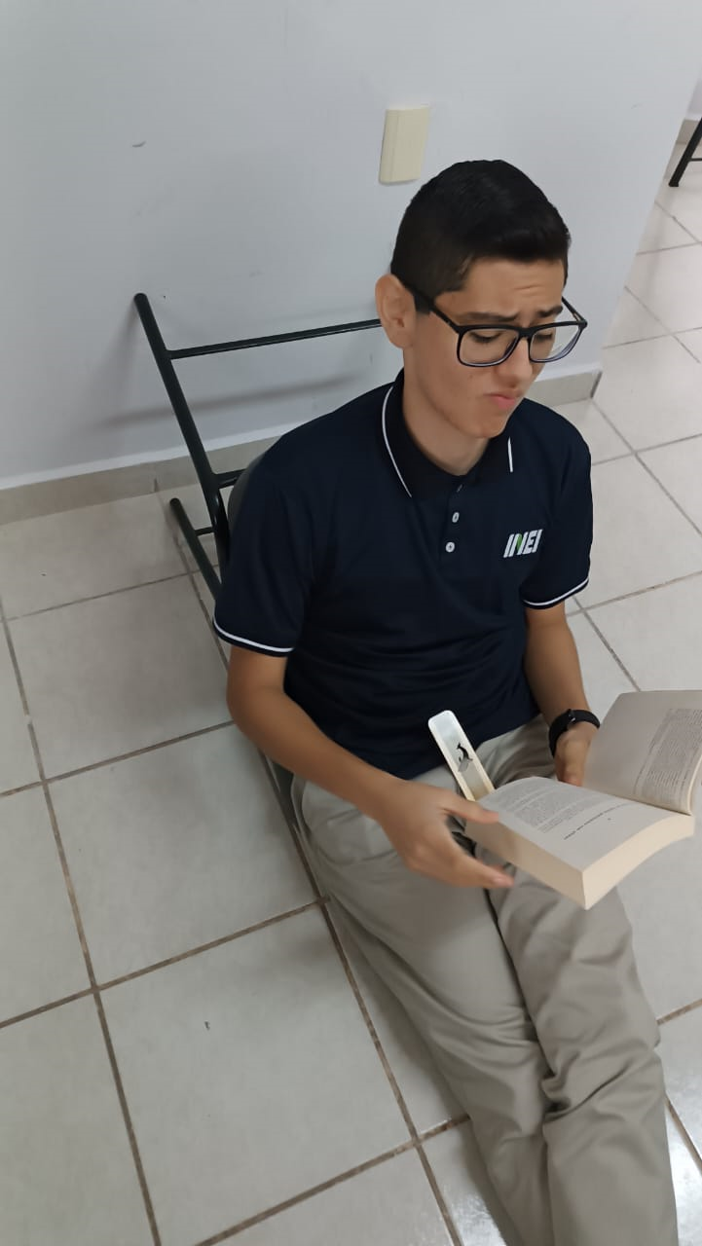
In this photo I am reading Percy Jackson, when I read I am a relaxed person, I love reading in my free time, when i finish my Reading session i feel more intelligent

Slide 3
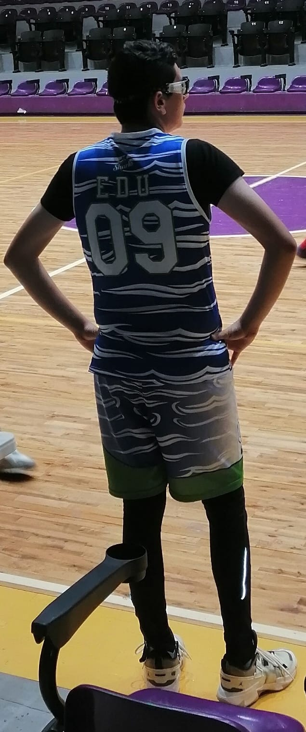
nervous
in this photo im playing basketball,when i play basket , im feel in my confort zone , im extroverted and sometimes i feel like Dirk Nowitzki

Slide 4
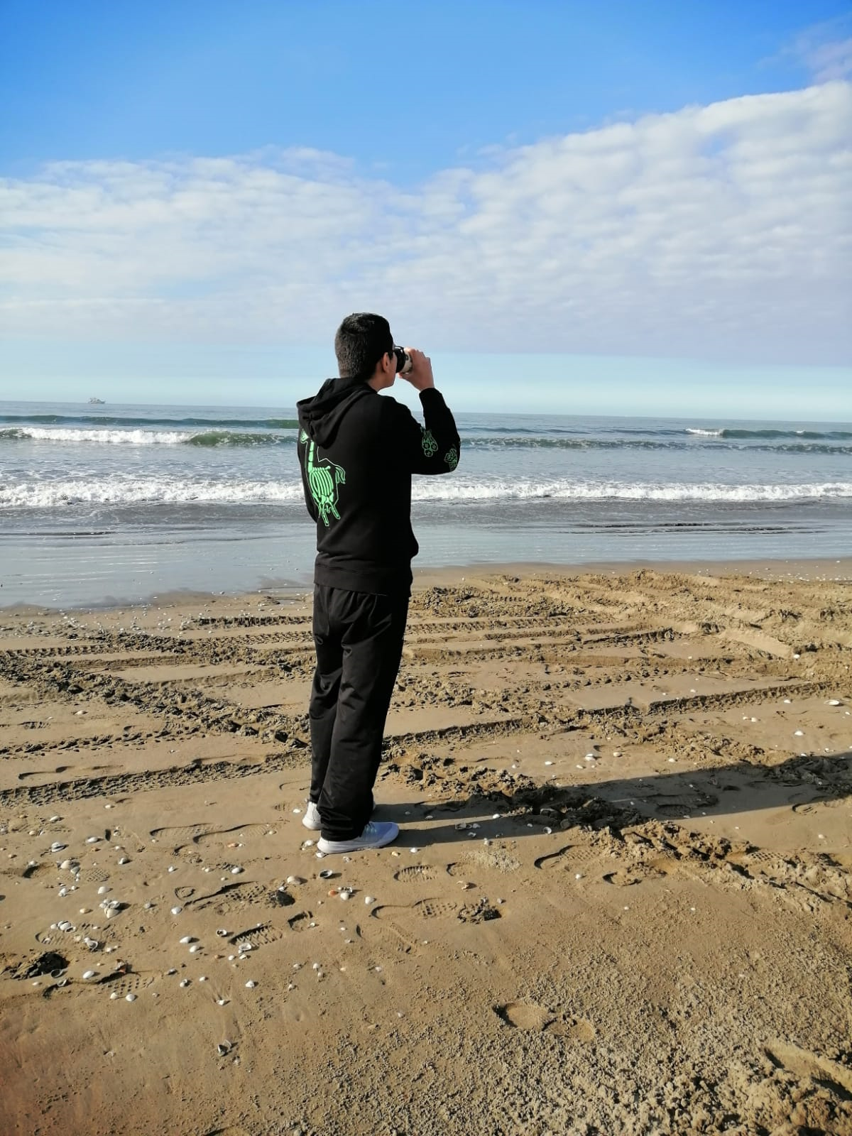
In this photo I am on the beach when I am on the beach I feel like a philosopher from ancient Greece, I organize my ideas and I feel happy

Slide 5
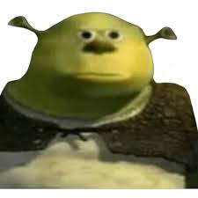
THANKS FOR YOUR ATENTTION

