Slide 1
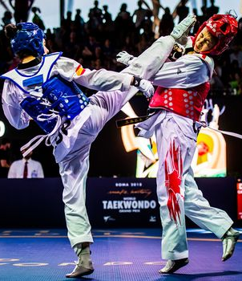
TAEKWONDO
XIMENA LOAIZA CASTRO

Slide 2
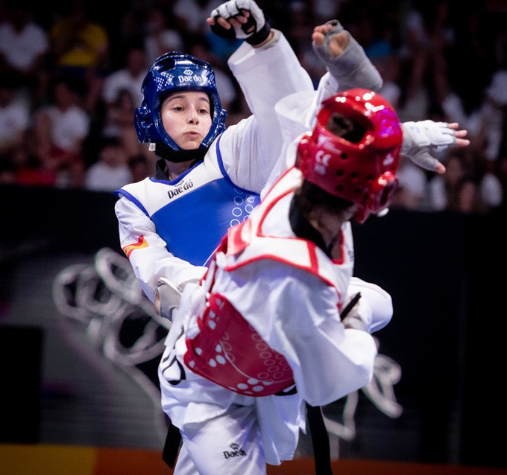
WHAT IS?
The Taekwondo is a Korean martial art that is practiced with the hands and feet.
Notes:
© Copyright Showeet.com: plantillas gratuitas de PowerPoint

Slide 3
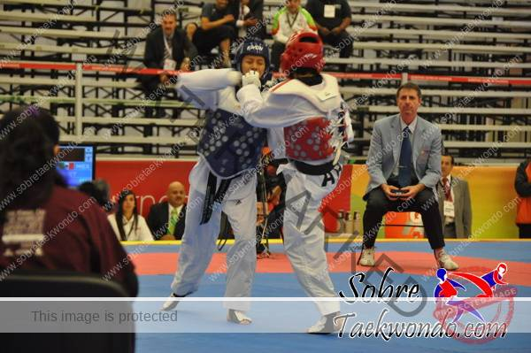
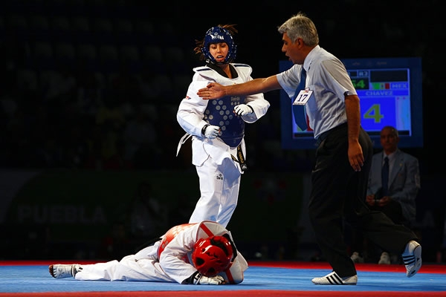
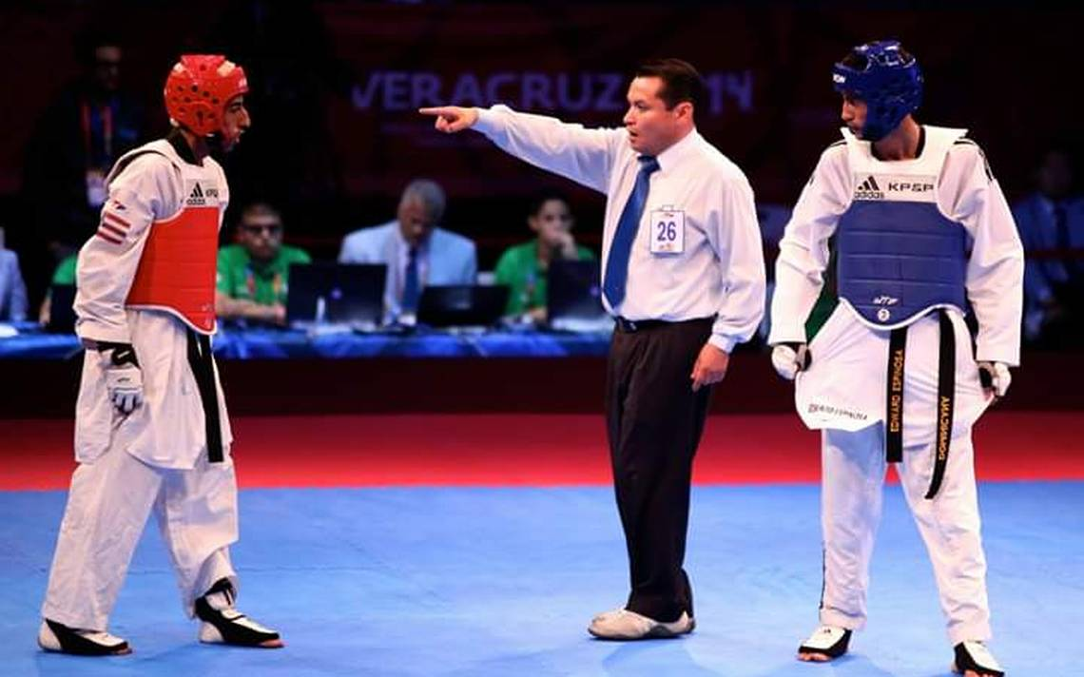
RULES
-Punches in the face
-Attack with the knee
-Attack below the waist
-Get out of the ring with both feet.
-Turn your back on your opponent
-Push, hold or grab your opponent
-Fake pain
Notes:
© Copyright Showeet.com: plantillas gratuitas de PowerPoint

Slide 4
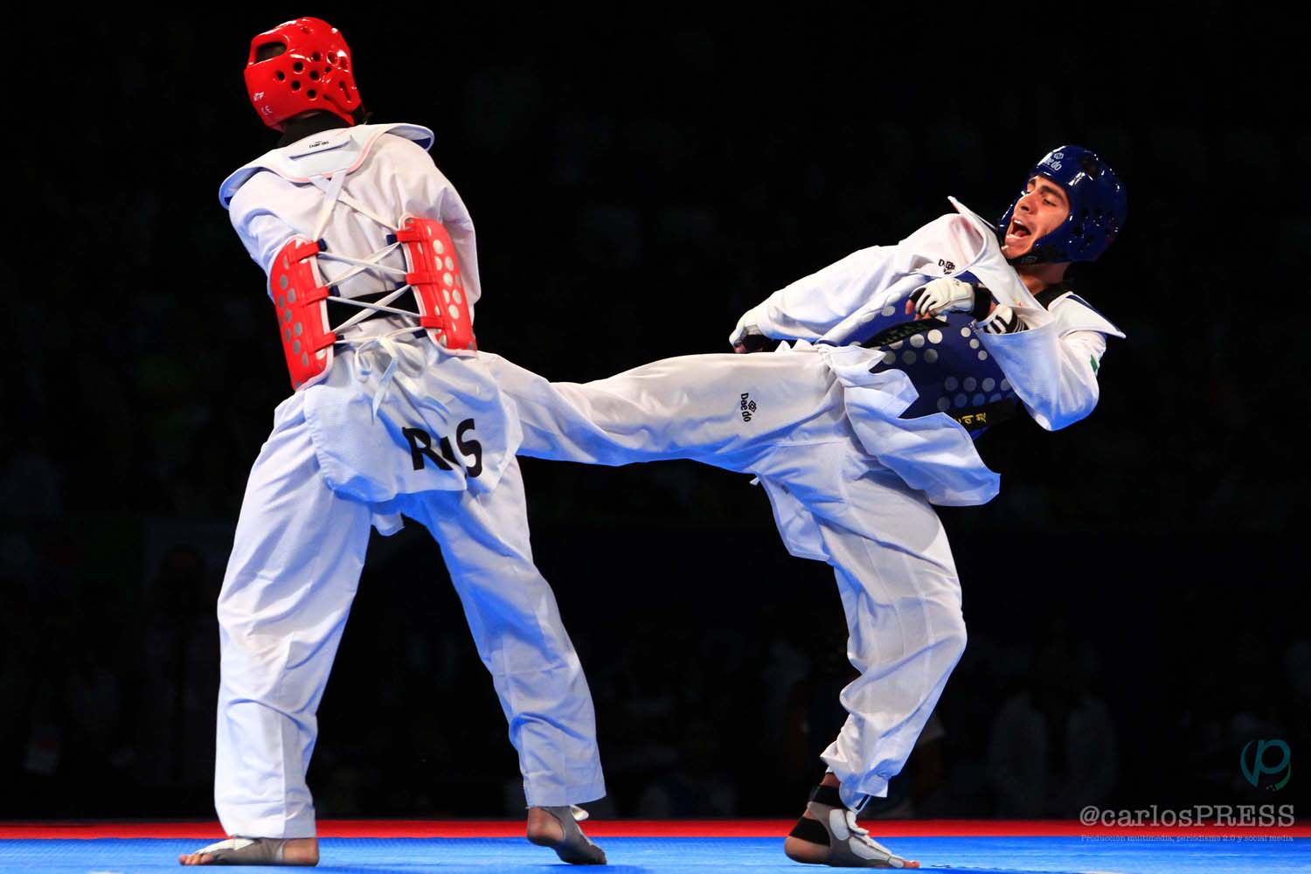
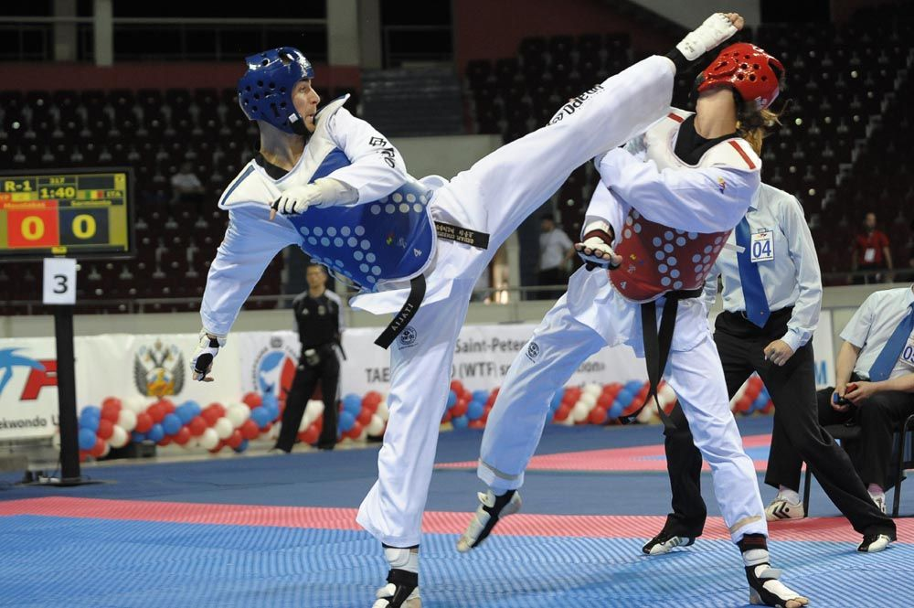
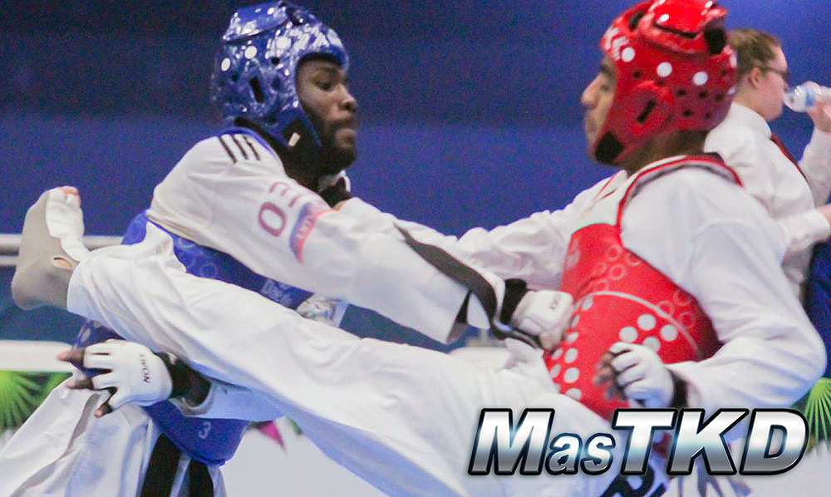
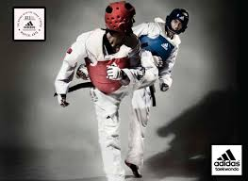
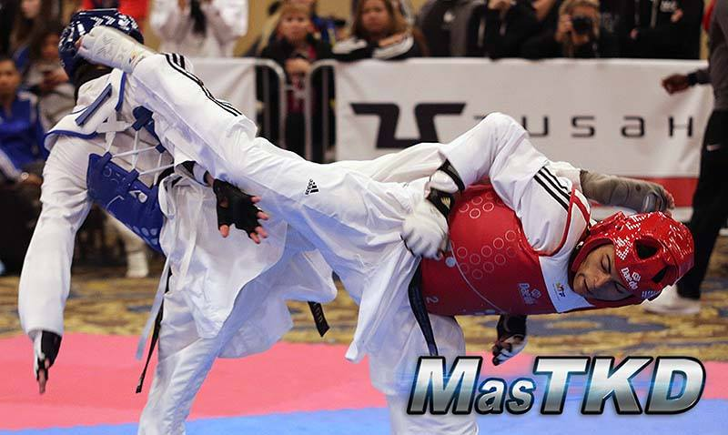
PUNCTUATION SYSTEM
FIST
KICK TO THE STOMACH
KICK TO THE HEAD
ROTATING KICK TO THE STOMACH
ROTATING KICK TO THE STOMACH

Slide 5
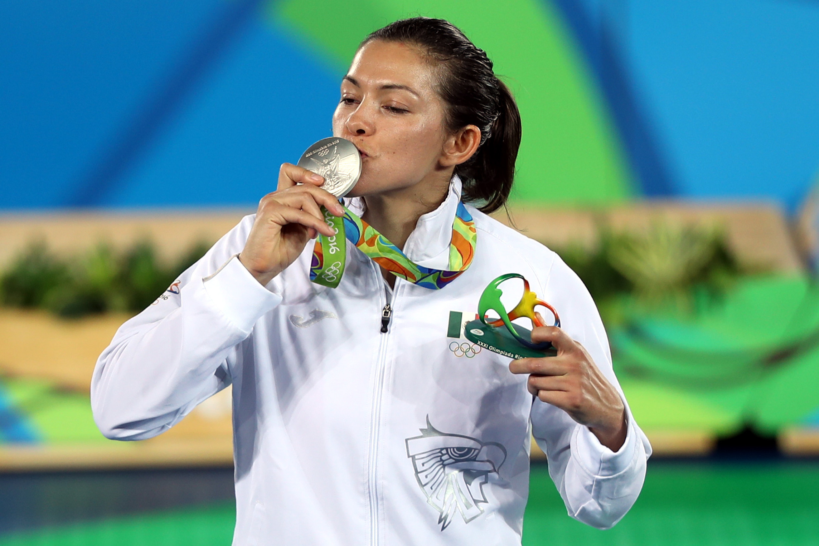
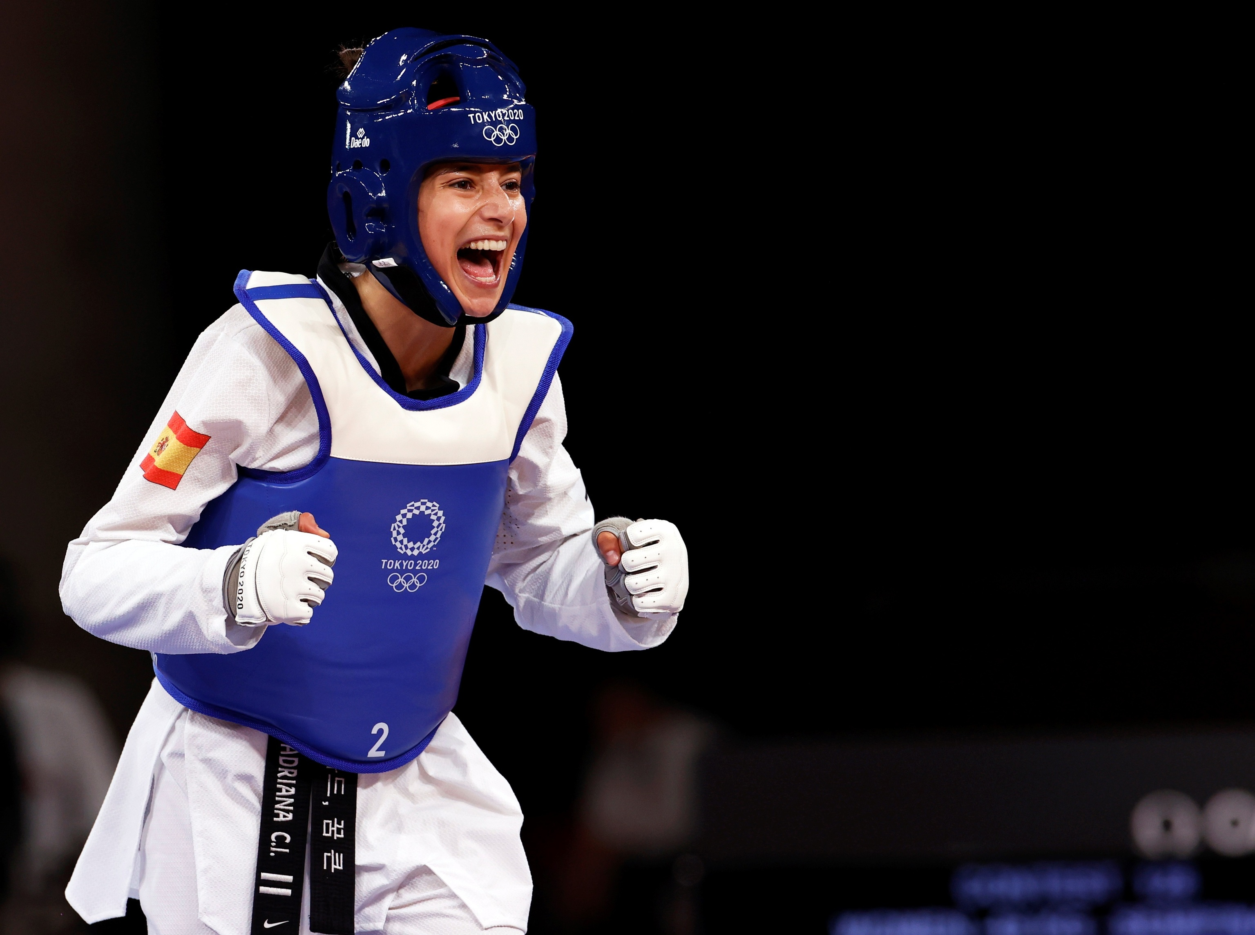
FAMOUS PEOPLE
MARIA DEL ROSARIO
ADRIANA CEREZO
-Pan-American Champion
-World champion
-National champion
-Triple medalist in olympic games
-Olympic Games silver medalist
-European Champion in 2021
-European multi-medallist
-National Champion

Slide 6
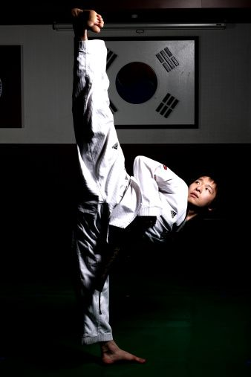
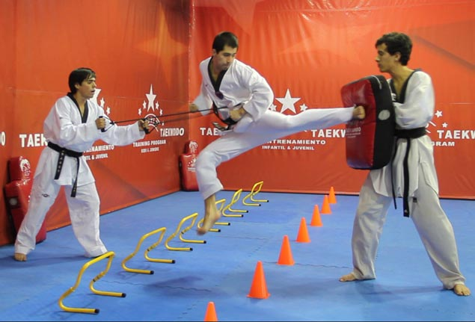

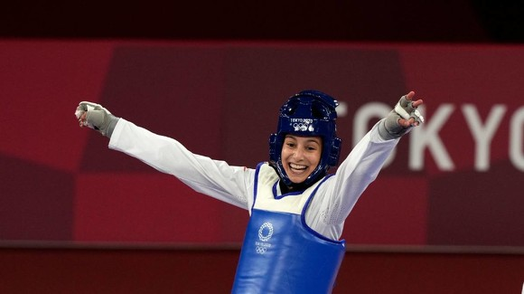
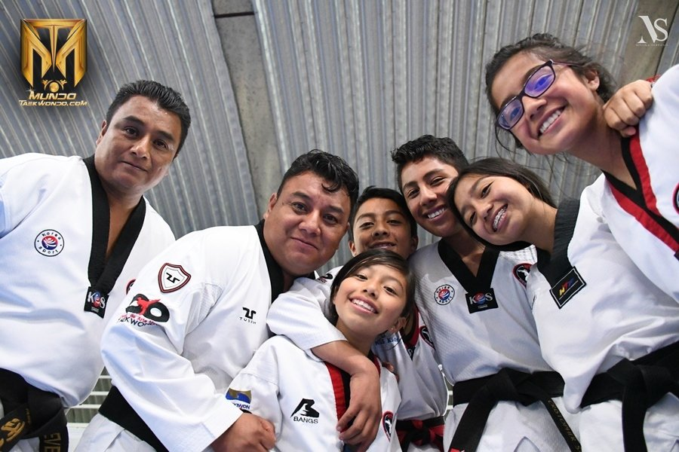
BENEFITS

