Slide 1
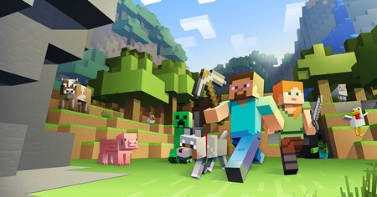
Minecraft
By: Jorge

Slide 2
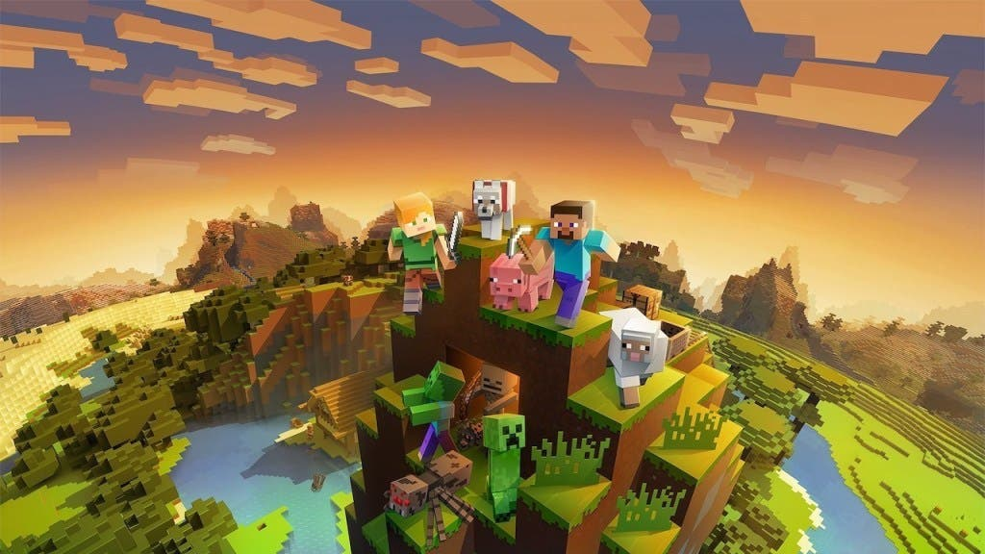
What is Minecraft
Minecraft is a game that came out in 2011 and is a sandbox type game and

Slide 3
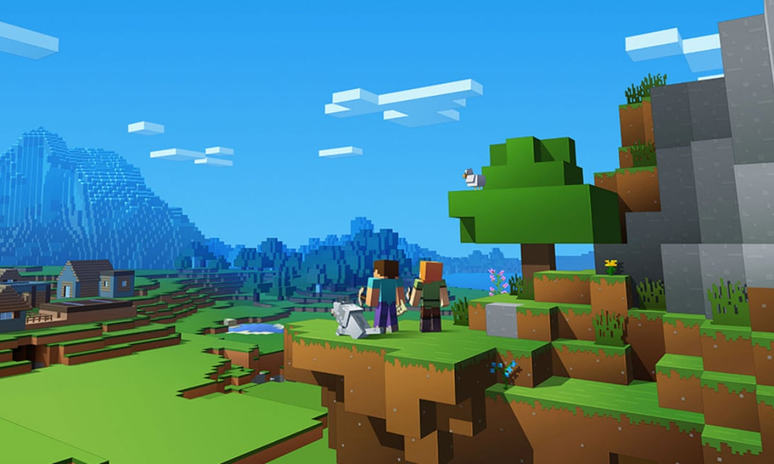
what was your success story?
Minecraft is currently the best selling game in history with over 200 million copies today.

Slide 4


Slide 5

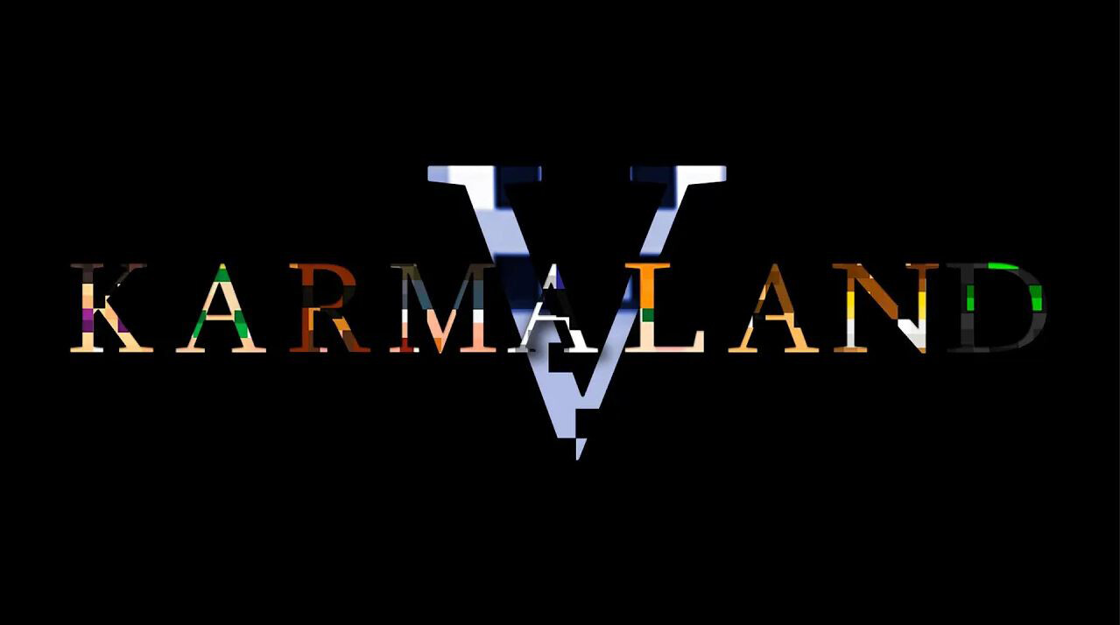

Slide 6
Example 2 famous minecraft series today are
in the community English is the dream SMP
and in the Spanish-speaking community Karmaland

Slide 7
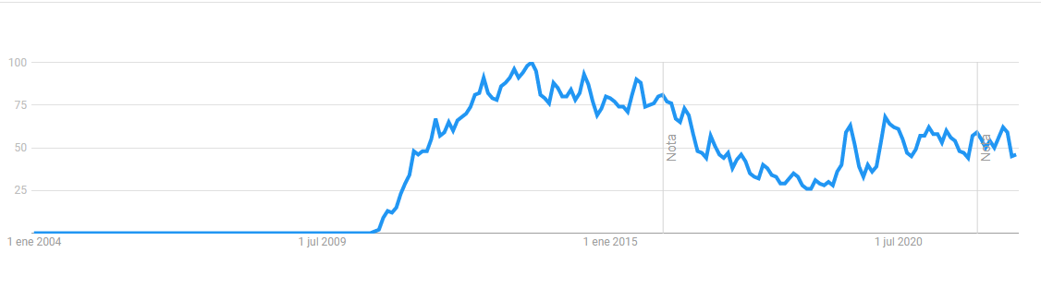

Slide 8



Slide 9
thanks for listening

