Slide 1


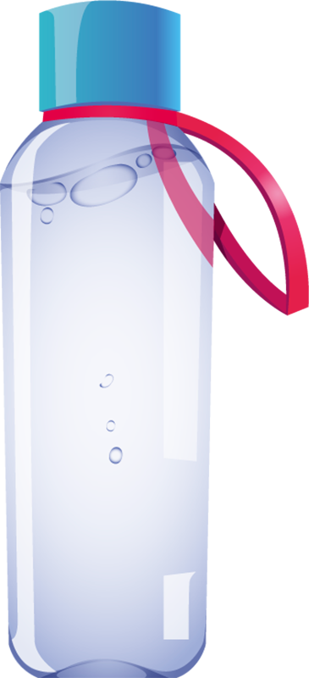



Bottle challenge or (water bottle flipping challenge)
By Carolina, Joan and Evelyn

Slide 2


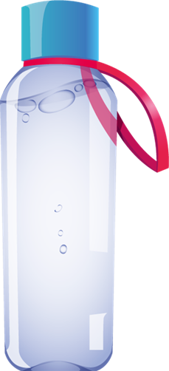
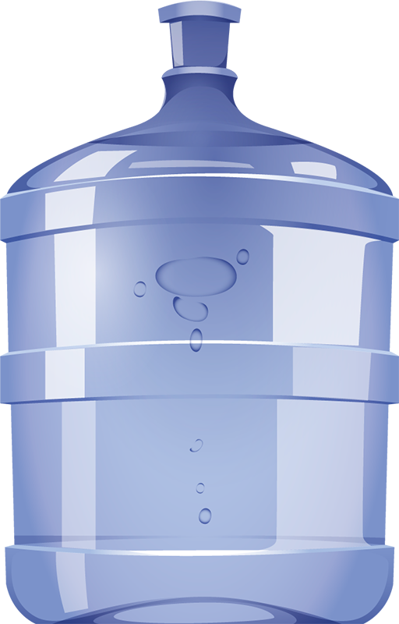
How did this trend come about?
This trends emerged in the summer of 2016 by teenagers who Michael Senatore, 18, has gone down in internet history as the 'guy who threw the water bottle'. It all started last May when he appeared at his Ardrey Kell Institute's talent show in Charlotte, South Carolina, with a bottle. He flipped her over on a table and landed on her feet.Oct 3, 2016

Slide 3

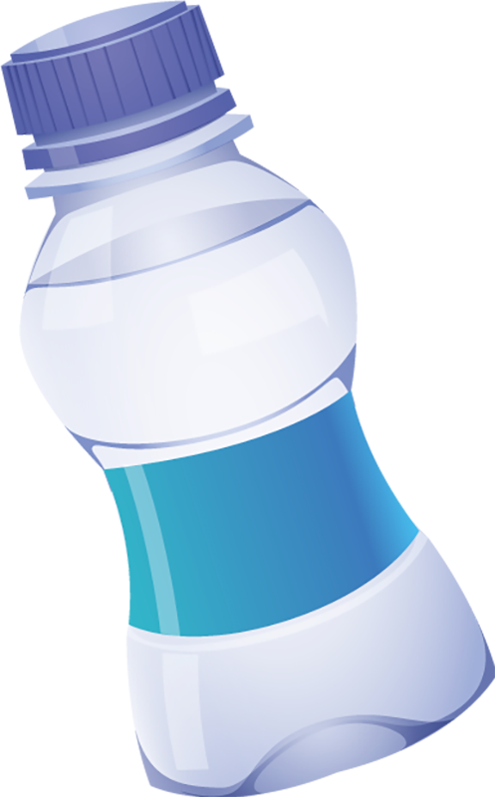
What is this trend about?
Try tossing a half-filled plastic bottle into the air, making it spin and land on its feet.

Slide 4

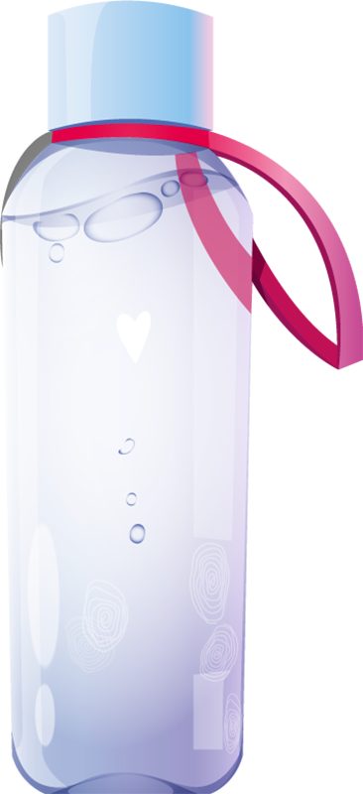
How to play?
The bottle challenge is pretty simple and just involves throwing a half-filled plastic bottle into the air, making it spin and landing on its feet. There are only two alternatives to the challenge, failure, which makes us enter the pile or hit the base, making us look good with the challenge.

Slide 5

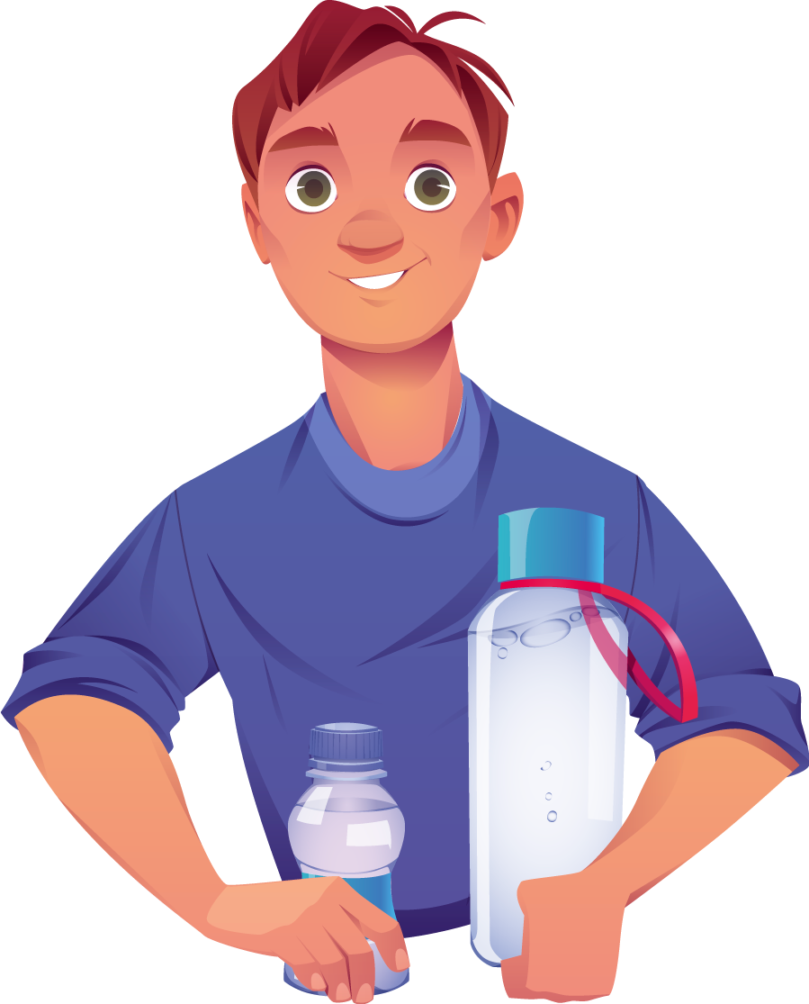
What are your rules?
According to the rules of the game, if you fail, you're in the heap. If you achieve it with the base, you look good. If it lands with the plug, you become a wizard, able to mold air, plastic and water thanks to your powers from another galaxy.

